Slide 1
Cognitive Behavior Therapy (CBT)
Presented by:
Komal Rana
Nursing Tutor/Nursing Coordinator
Akal College of Nursing/ADDAC

Slide 2
Introduction
CBT emerged during the 1960s and originated in the work of psychiatrist Aaron Beck, who noted that certain types of thinking contributed to emotional problems. Beck labeled these 'automatic negative thoughts' and developed the process of cognitive therapy.

Slide 3
Where earlier behavior therapies had focused almost exclusively on associations, reinforcements, and punishments to modify behavior, the cognitive approach addressed how thoughts and feelings affect behaviors. Since then, CBT has emerged as an effective first-line treatment for a wide range of disorders and conditions.

Slide 4
Definition
CBT is a form of psychotherapy that integrates theories of cognition and learning with treatment techniques derived from cognitive therapy and behavior therapy. CBT assumes that cognitive, emotional, and behavioral variables are functionally interrelated.
- APA

Slide 5
Principles
Psychological problems are based, in part, on faulty or unhelpful ways of thinking.
Psychological problems are based, in part, on learned patterns of unhelpful behavior.
People suffering from psychological problems can learn better ways of coping with them, thereby relieving their symptoms and becoming more effective in their lives.

Slide 6
Indications
Panic Disorder
Post-traumatic Stress Disorder (PTSD)
Insomnia
Social Phobia
Childhood Depression
Dental Phobia
Eating Disorders
Anger
Marital Conflict
Substance Abuse And Addiction
Borderline Personality
Generalized Anxiety Disorder (GAD)

Slide 7
Who can be a therapist?
Psychotherapist is a general term, rather than a job title or indication of education, training or licensure. Examples of psychotherapists include psychiatrists, psychologists, licensed professional counselors, licensed social workers, licensed marriage and family therapists, psychiatric nurses, or other licensed professionals with mental health training.

Slide 8
Strategies used to change thinking
Learning to recognize one's distortions in thinking that are creating problems, and then to reevaluate them in light of reality.
Gaining a better understanding of the behavior and motivation of others.
Using problem-solving skills to cope with difficult situations.
Learning to develop a greater sense of confidence is one's own abilities.

Slide 9
Strategies used to change behavioral patterns
Facing one's fears instead of avoiding them.
Using role playing to prepare for potentially problematic interactions with others.
Learning to calm one's mind and relax one's body.

Slide 10
Learning tools for CBT
Regular one-to-one or group discussion sessions, or a combination of both
Frequent feedback
Role-playing activities
Ways to calm the mind and body
Gradually increasing exposure to things that cause fear
Homework assignments
Keeping a cognitive behavioral diary
Practicing the skills learned to promote positive behavioral change and growth

Slide 11
Sessions of CBT
Cognitive behavioral therapy may be done one-on-one or in groups with family members or with people who have similar issues.
CBT often includes:
  Learning about your mental health condition
  Learning and practicing techniques such as relaxation, coping, resilience, stress management and assertiveness

Slide 12

Session 1

Slide 13

Session 2

Slide 14
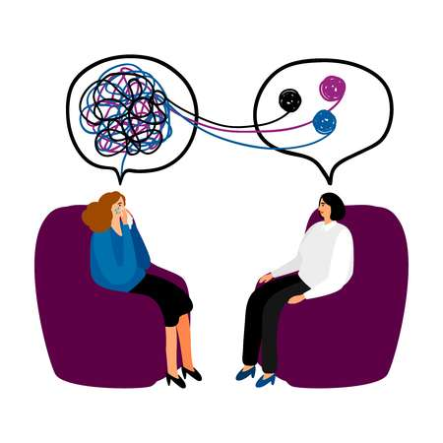
Further Sessions

Slide 15
Steps in CBT
Identify the troubling situations or conditions in life.
Making person aware of his/her thoughts, emotions and beliefs about these problems.
Helping person in identifying negative or inaccurate thinking.
Reshape negative or inaccurate thinking.

Slide 16
Length of CBT
Usually ranging from 5 – 20 therapy sessions but depends upon the problems and condition of the individual.

Slide 17
Conclusion
CBT is a form of psychotherapy where a person learns to change their perceptions, and how they see things in their life. This can have a positive effect on behavior and mood.
CBT can help people with many problems, ranging from depression to chronic pain.
A counselor and client work together to identify goals and expected outcomes. The individual must be an active participant to benefit.

Slide 18


