Slide 1
Coronavirus (CoVID-19) Epidemiology

Slide 2
Coronavirus disease 2019(COVID-19): Background
In December 2019, a pneumonia outbreak was reported in Wuhan, China.
On December2019, the outbreak was traced to a novel strain of Coronavirus, which was given the interim name 2019-nCov by the World Health Organization.
Later renamed SARS-CoV-2 by the international committee on taxonomy of viruses.
The disease caused by SARS-CoV-2 is named as coronavirus disease-2019(COVID-19).

Slide 3
Timeline of the spread of COVId-19 Pandemic
12th Dec 2019 Wuhan reported first case
31 Dec Chinese authorities alerted WHO about cases of Pneumonia of unknown etiology
1st Jan 2020 Wuhan seafood Market Closed
3rd Jan India notified By WHO Declared PHEIC
7th Jan 2020 –nCov Identified
12th Jan Wuhan’s first death

Slide 4
Timeline of the spread of COVId-19 Pandemic
13th Jan Thailand Confirm first case outside china
Jan 21 Washington state reported the first case
30th Jan India confirm first case
11th Feb Virus renamed SARS-CoV-2 and diseases COVID-19
28Feb WHO regional global risk Very high
March 11 WHO declares COVID-19 as Pandemic

Slide 5
Distribution of cases globally

Slide 6
Cont….

Slide 7
Distribution of cases in India

Slide 8
Distribution of cases in Punjab

Slide 9
Distribution of cases in Himachal Pradesh

Slide 10
What is Coronavirus?
Coronaviruses are large family of Viruses which may cause illness in animals or human ranging from common cold to more severe disease Such as :
Severe Acute Respiratory Syndrome(SARS-CoV): 2003 (China)
Middle East Respiratory Syndrome (MERS-CoV): 2012 (Saudi Arabia)
A novel coronavirus (NCoV), a new strain that has not been previously identified in humans: 2019 (China).

Slide 11
Cont…
There are four subgroups: Alpha, beta, gamma and delta.
Alpha and beta coronaviruses are known to infect humans.
Consumption of infected animal-major cause of animal to human transmission of Healthy person.
The most recently Discovered Coronavirus causes coronaviruses Disease COVID-19.

Slide 12
Cont..

Slide 13
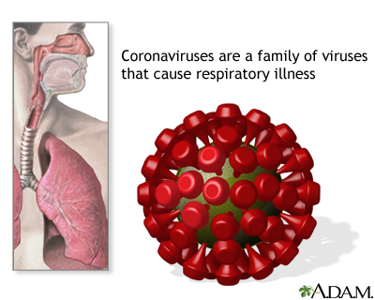
What is novel coronavirus?
Spill over from an animal to human happened during the last quarter of 2019 in Wuhan City, Hubei Provinces, China.
The Wuhan Strain has been identified as new strain of Beta coronavirus from group 2B with approximately 70% genetic similarity to the SARS-CoV.
The Virus has a 96% similarity to a bat coronavirus, so it is widely suspected to originate from bats as well.

Slide 14
Cont..
Most likely ecological reservoir for SARS-CoV-2 are bats, but it is believed that the virus jumped the species barrier to human from another intermediate animal host.
Intermediate animal host could be a domestic food animal, a wild animal or a domesticated wild animals which has not yet been identified.

Slide 15
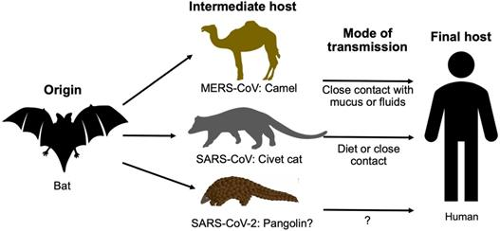
Origin of the virus

Slide 16
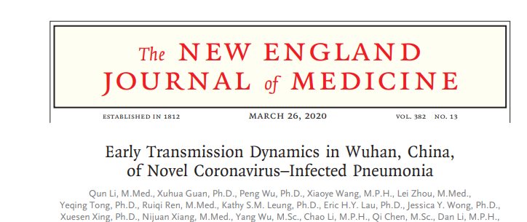
Assessment of the transmission dynamics in the first 425 confirmed cases found that:
55% of the cases before 1st January 2020 were linked to the south China sea food market
8.6% of cases after this date were linked the to market.
This confirms that human-to-human transmission has occurred among close contacts since the middle of December 2019 including infections in the health care workers

Slide 17
Mode of transmission
Person to person spread
Close contact with respiratory droplets
Direct contact with the infected people
Contact with fomites
Airborne transmission has not been reported. However, it may be possible during aerosol generating procedures in clinical care.
Pre-symptomatic transmission
Asymptomatic transmission
Vertical transmission (Unknown)
Symptomatic transmission

Slide 19
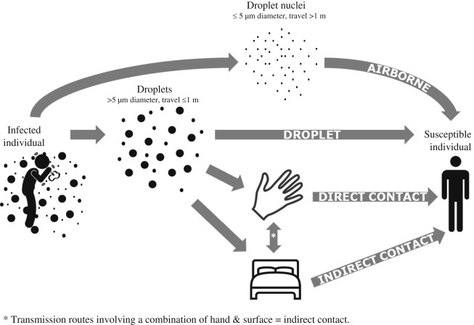
Mode of Transmission

Slide 20
Research evidence

Slide 21
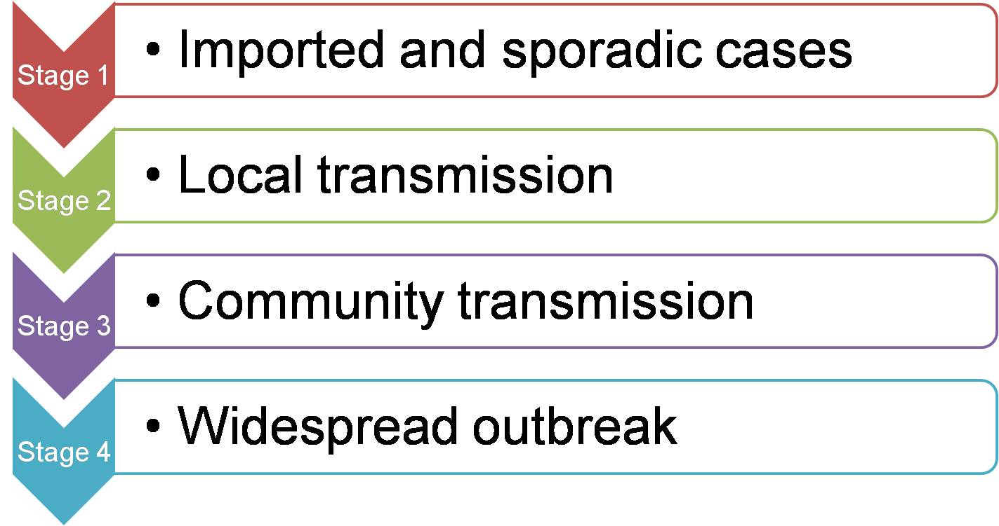
Stages of COVID-19
Source: https://www.icmr.nic.in/content/covid-19

Slide 22
Reproductive Number Scale

Slide 23
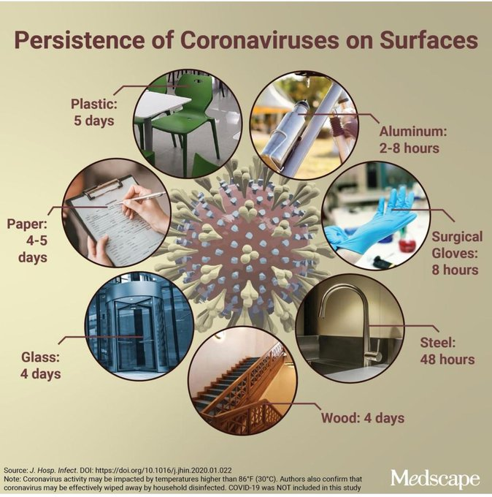
Persistence of Virus on various surfaces

Slide 24
Sign / symptoms

Slide 25
Sign / symptoms

Slide 26
Incubation Period

Slide 27
New symptoms
https://weather.com/en-IN/india/coronavirus/news/2020-04-28-six-new-coronavirus-symptoms-recognised-cdc-covid-19...accessed on 2.5.2020

Slide 28
Case definition: When to suspect

Slide 29
Case definition

Slide 30
Case definition

Slide 31
Who are at risk?

Slide 32
Diagnostic measures: BRIEF
Category for covid testing: ICMR
Category 1:symptomatic individuals who have undertaken international travel in the last 14 days.
Category 2: all symptomatic contacts of laboratory confirmed cases
Category 3: All symptomatic health care workers
Category 4: All patients with SARI (Fever, cough)

Slide 33
Diagnostic measures: BRIEF
Category 5B: Asymptomatic health care workers in contact with confirmed case without adequate protection
Hotspots/clusters and in large migration gathering/evacuees centers:
Category 6: All symptomatic ILI (Fever, cough, sore throat, runny nose)

Slide 34
Sample collection
Upper respiratory tract
Nasopharyngeal swabs
Oropharyngeal
Other
Nasopharyngeal wash/ aspirate or nasal aspirate, deep Nasal swabs, anterior nares specimens
Lower respiratory tract
Broncho alveolar lavage
Tracheal aspirate
Pleural fluid
Lung biopsy
Sputum

Slide 35
Storage
Cold chain
2-8C up to 72 hours
In case of delay in testing or shipping store the specimen at -70C or below . (Bio safety cabinet)

Slide 36
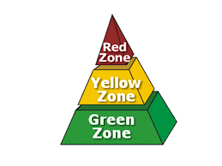
Zones in COVID

Slide 37
Prevention

Slide 38
Thank You

