Slide 1
PREVENTIVE ASPECTS AGAINST
COVID-19
Presenters : Ms. Anjali, Ms. Mahima , Ms. Manisha

Slide 2
Today’s session:
Preventive Aspects Against COVID-19
Ms. Anjali Sharma
General consideration at community level
Ms. Mahima
Standard of precaution required at Hospital level
Ms. Manisha
General consideration at Home

Slide 3
Preventive Aspects Against
COVID-19
Overview: General consideration
Prevention of infection
Chain of transmission
How to break the chain
Hand hygiene
Respiratory etiquettes
Social Distancing

Slide 4
General Cons....
Prevention of infection
Why there is a need to take preventive measures seriously ??

Slide 5
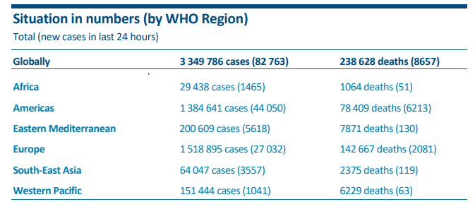
1. Health care system in crisis:
WHO- Coronavirus disease (COVID-19) Situation Report – 104 (3rd May 2020)

Slide 6
2. Non specific symptoms :
Disease presentation can range from no symptoms to severe symptoms like pneumonia and death
Symptoms | Percentage | Symptoms | Percentage
Fever | 87.9% | Headache | 13.6%
Dry cough | 67.7% | Myalgia/ arthralgia | 14.8%
Fatigue | 38.1% | Chills | 11.4%
Sputum production | 33.4% | Nausea or Vomiting | 5.0%
SOB | 18.6% | Nasal Congestion | 4.8%
Sore throat | 13.9% | Diarrhoea | 3.7%
Report of the WHO-China Joint Mission on Coronavirus Disease 2019 (COVID-19), 16-24 February 2020
Notes:
Lack of information : Vertical transmission, Treatment, Vaccine

Slide 7
3. Transmission of COVID-19
Symptomatic transmission: refers to transmission from a person while they are experiencing sign and symptoms of COVID-19 Virus infection
Shedding of virus is highest in upper respiratory tract (Nose & Throat) in the early course of disease i.e.1st -3days from onset of symptoms
World authority ‘Coronavirus disease 2019 (COVID-19), Situation report -73, 2nd April 2020

Slide 8
General Cons....
Transmission of COVID-19
Pre-symptomatic transmission:
IP:
Average-5-6days
Up to 14 days
Onset of symptoms
Exposure to the virus
World authority ‘Coronavirus disease 2019 (COVID-19), Situation report -73, 2nd April 2020

Slide 9
General Cons....
Transmission of COVID-19
3. Asymptomatic transmission: refers to transmission of the virus from a person who does not develops symptoms
World authority ‘Coronavirus disease 2019 (COVID-19), Situation report -73, 2nd April 2020

Slide 10
General cons....
Basic Reproduction Number (Ro)
Is the expected number of cases directly generated by one person in a population where all individuals are susceptible to infection.
The higher the infection number the more likely is an epidemic
World authority ‘Coronavirus disease 2019 (COVID-19), Situation report -73, 2nd April 2020

Slide 11
General cons....
Basic Reproduction Number (Ro)
Disease | Transmission | Ro
Influenza (2009 Pandemic) | Airborne droplet | 1.4-1.6
Ebola | Airborne droplet | 1.5-2.5
SARS | Airborne droplet | 2-5
COVID-19 | Airborne droplet | 1.4-5.7
World authority ‘Coronavirus disease 2019 (COVID-19), Situation report -73, 2nd April 2020

Slide 12
General cons....
Chain of transmission
World authority ‘Coronavirus disease 2019 (COVID-19), Situation report -73, 2nd April 2020

Slide 13
General cons....
Feco-oral transmission of COVID-19
Studies have shown the presence of SARS-C0V2 in the feces of the infected patients / persons.
But can this shedded virus infect another person, needs to be studied.
There is lack of data to suggest that this virus shedding can cause feco-oral transmission and infection.
The oro-digestive tract of human beings do have the Angiotensin Converting Enzyme receptors which is the target of COVID-19 virus, so the fact of possible feco-oral transmission of COVID-19 cannot be denied.
It needs further studies to confirm this route of transmission.
Amirian ES. Potential Fecal Transmission of SARS-CoV-2: Current Evidence and Implications for Public Health. Int J Infect Dis. 2020 Apr 23. pii: S1201-9712(20)30273-3.

Slide 14
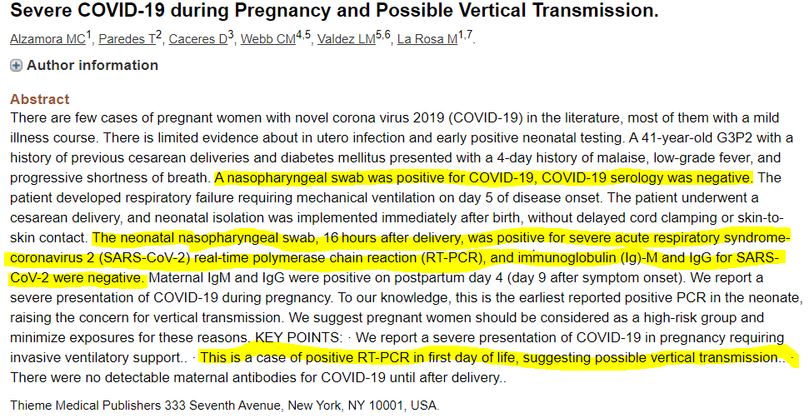
General cons....
Vertical transmission of COVID-19
.
Alzamora MC, Paredes T, Caceres D, Webb CM, Valdez LM, La Rosa M. Severe COVID-19 during Pregnancy and Possible Vertical Transmission. Am J Perinatol. 2020 Apr 18;

Slide 15
General cons....
General WHO advice for COVID-19
1. Practice frequent hand hygiene, especially after direct contact with ill people or their environment
2. Practice social distancing: avoid close contact with people, especially those suffering from acute respiratory
infections
3. For those with symptoms of acute respiratory infection, they should isolate themselves and practice respiratory etiquette, wear a medical mask and seek medical care if in
respiratory distress

Slide 16
General cons....
General WHO advice for COVID-19 : Hand Hygiene
Best way to prevent the spread of germs in any setting
Door handles
Instruments
Medication
Cellphones
Caregivers

Slide 17
General cons....
Hand Hygiene: WHO 5 moments
https://www.who.int/infection-prevention/tools/hand-hygiene/en/

Slide 18
General cons....
Hand hygiene: HOW
Rub hands for 20–30 seconds!
Soap, running water and single use towel
Wash hands for 40–60 seconds!
https://www.who.int/infection-prevention/tools/hand-hygiene/en/

Slide 19
General cons....
How soap is effective
The virus of COVID-19 protects itself with an oily lipid membrane.
The hydrophobic tail of the soap molecule binds with oil and fats.
This hydrophobic tail stabs into the COVID-19 virus like puncturing a tyre and hence the sack of the virus breaks and make the virus ineffective.
Alcohol can also break the oily membrane but washing with soap has added benefit of physically removing the viruses from the skin.
https://en.unesco.org/news/how-soap-kills-covid-19-hands

Slide 20
General cons....
Why 60-70 % Alcohol rub / Sanitizer
(60% ethanol or 70% isopropyl alcohol )
Isopropyl alcohol 70% is pure isopropanol diluted with 30 percent purified water.
Alcohol based sanitizers kill the COVID-19 virus by denaturing its wall.
When 99 % or higher than 70 % isopropyl alcohol is used. It evaporates very quickly and doesn’t allow it to penetrate the wall of the virus.
But there are other viral structures, like the norovirus, which cannot be killed with the use of any concentration of alcohol. That's why hand washing remains as supreme & the most effective method for removing every form of virus and bacteria.
https://www.marthastewart.com/7796118/isopropyl-alcohol-percent-disinfectant-coronavirus-covid-19
CDC. Coronavirus Disease 2019 (COVID-19) – Prevention & Treatment [Internet]. Centres for Disease Control and Prevention. 2020 [cited 2020 May 3]. Available from: https://www.cdc.gov/coronavirus/2019-ncov/prevent-getting-sick/prevention.html

Slide 21
https://www.who.int/infection-prevention/tools/hand-hygiene/en/

Slide 22
General cons....
Respiratory etiquette
Cover coughs and sneezes
If you are in a private setting and do not have on your cloth face covering, remember to always cover your mouth and nose with a tissue when you cough or sneeze or use the inside of your elbow.
Throw used tissues in the trash.
Wash your hands with soap and water for at least 20 seconds.
CDC. Coronavirus Disease 2019 (COVID-19) – Prevention & Treatment [Internet]. Centres for Disease Control and Prevention. 2020 [cited 2020 May 3]. Available from: https://www.cdc.gov/coronavirus/2019-ncov/prevent-getting-sick/prevention.html

Slide 23
General cons....
Face Mask
Cover your mouth and nose with a cloth face cover when around others
You could spread COVID-19 to others even if you do not feel sick.
Everyone should wear a cloth face cover when they have to go out in public, for example to the grocery store or to pick up other necessities.
Cloth face coverings should not be placed on young children under age 2, anyone who has trouble breathing, or is unconscious, or otherwise unable to remove the mask without assistance.
The cloth face cover is meant to protect other people in case you are infected.
Do NOT use a facemask meant for a healthcare worker.
Continue to keep about 6 feet (2m) between yourself and others. The cloth face cover is not a substitute for social distancing.
CDC. Coronavirus Disease 2019 (COVID-19) – Prevention & Treatment [Internet]. Centres for Disease Control and Prevention. 2020 [cited 2020 May 3]. Available from: https://www.cdc.gov/coronavirus/2019-ncov/prevent-getting-sick/prevention.html

Slide 24
General cons....
Social Distancing
Avoid close contact
Avoid close contact with people who are sick and put distance between yourself and other people.
Remember that some people without symptoms may be able to spread virus.
Keeping distance from others is especially important for people who are at higher risk of getting very sick.
CDC. Coronavirus Disease 2019 (COVID-19) – Prevention & Treatment [Internet]. Centres for Disease Control and Prevention. 2020 [cited 2020 May 3]. Available from: https://www.cdc.gov/coronavirus/2019-ncov/prevent-getting-sick/prevention.html

Slide 25
Coronavirus & Surfaces
Surfaces | Examples | Duration
Metal | Doorknobs, Jewellery, Silverware | 5 Days
Wood | Furniture, Decking | 4 Days
Plastics | Detergent Bottles, Subway And Bus Seats, Elevator Buttons | 2 To 3 Days
Paper | Newspaper, books | Few mins to 5 Days
Ceramics | Dishes, Pottery, Mugs | 5 Days
Glass | : Drinking Glasses, Measuring Cups, Mirrors, Windows | Up To 5 Days
Aluminium | : Soda Cans, Tinfoil, Water Bottles | 2 To 8 Hours
Stainless Steel | Refrigerators, Pots And Pans, Sinks | 2 To 3 Days
Cardboard | Shipping Boxes | 24 Hours
https://www.webmd.com/lung/how-long-covid-19-lives-on-surfaces
Notes:
Stainless steel refrigerators, pots and pans, sinks, some water bottles 2 to 3 days
Cardboard Examples: shipping boxes 24 hours
Copper Examples: pennies, teakettles, cookware 4 hours

Slide 26
General cons....
Clean and disinfect
Clean AND disinfect frequently touched surfaces daily. This includes tables, doorknobs, light switches etc..
If surfaces are dirty, clean them. Use detergent or soap and water prior to disinfection. Then, use a household disinfectant.
CDC. Coronavirus Disease 2019 (COVID-19) – Prevention & Treatment [Internet]. Centres for Disease Control and Prevention. 2020 [cited 2020 May 3]. Available from: https://www.cdc.gov/coronavirus/2019-ncov/prevent-getting-sick/prevention.html

Slide 27
General cons....
COVID - MYTH BUSTERS (WHO 2020)
There are currently no drugs licensed for treatment or prevention of COVID-19
Adding pepper to your soup or other meal does not prevent or treat COVID-19
COVID-19 is not transmitted through housefly or mosquitoes
Spraying and introducing any other disinfectant into your body will not protect you against COVID-19 and can be dangerous
Drinking methanol, ethanol, alcohol or bleach does not prevent or cure COVID-19 & can be extremely dangerous.
Exposing yourself to sun or to temp. Higher then 25 C degree does not prevent the Corona Virus
Being able to hold your breath for 10 seconds or more without coughing or discomfort does not mean that you are free from Cornavirus or any other lung disease
Virus can be transmitted in areas with hot and humid environment
WHO- Coronavirus disease (COVID-19) Myth busters

Slide 28
Thank You
Ms. Mahima
Standards of Precaution required at Hospital level

