Slide 1
Prevention of covid 19 at home
Prepared by :
Ms. Manisha
Nursing tutor

Slide 2
What Should We Do at Home?
To protect others at home, someone who is sick should:
As much as possible, keep away from other people and pets in your home.

Slide 3
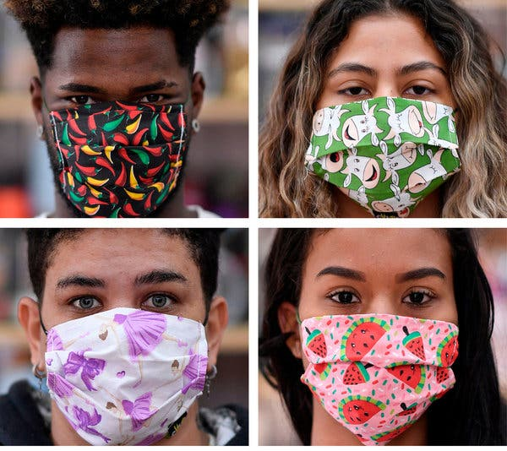
Wear a cloth face covering (or face mask, if you have one) if you are around other people.

Slide 4
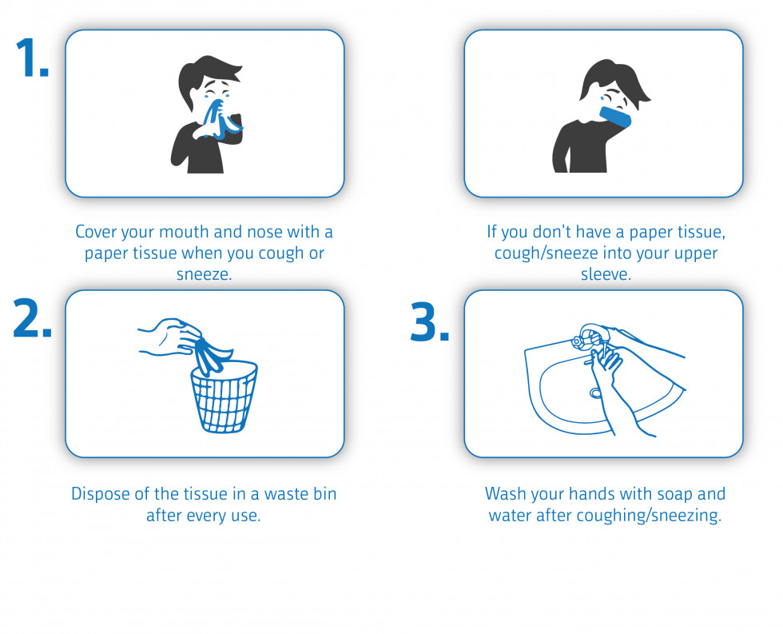
How to Cough and sneeze

Slide 5
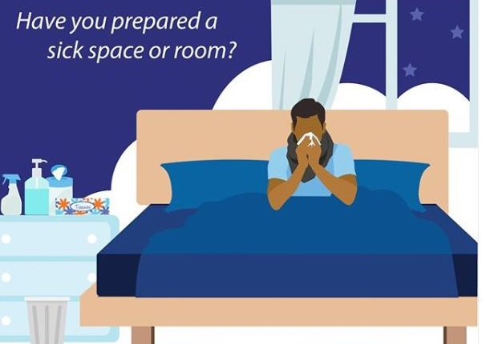
. If possible, stay in a bedroom and use a bathroom separate from other people in the home

Slide 6
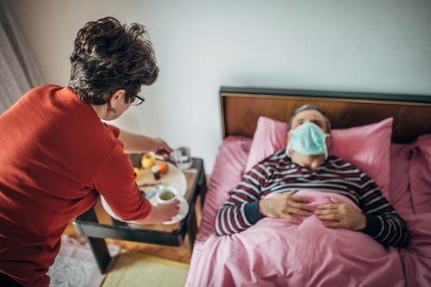
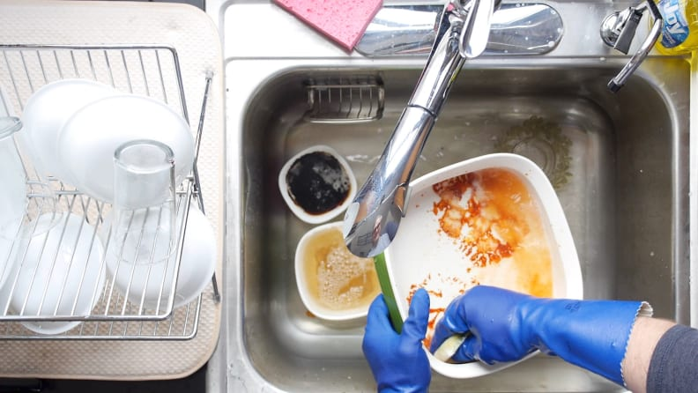
Use separate dishes, glasses, cups, and eating utensils and not share these with other household members. After use, run them through the dishwasher or wash with very hot soapy water.

Slide 7
Use separate bedding and towels and donot share these with other household members.

Slide 8
Also:
If the person who is sick can't wear a cloth face covering (or face mask), caregivers should wear one while they're in the same room.

Slide 9
Make sure shared spaces in the home have good air flow. You can open a window or turn on an air filter or air conditioner

Slide 10
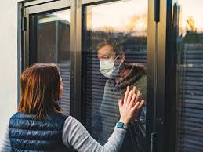
Do not allow visitors into your home. This includes children and adults.

Slide 11
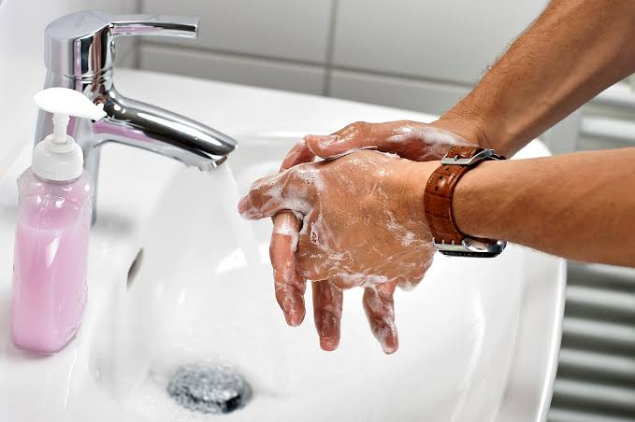
All household members should wash their hands well and often. Wash with soap and water for at least 20 seconds, or use alcohol-based hand sanitizer.

Slide 12
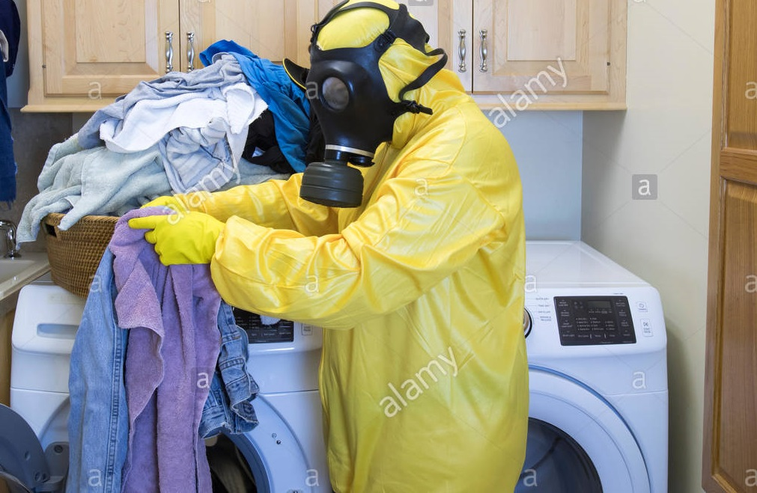
Wash the sick person's clothing, bedding, and towels with detergent on the hottest temperature possible. Wear gloves when handling their laundry, if possible. Wash your hands well after handling the laundry (even if you wore gloves).

Slide 13
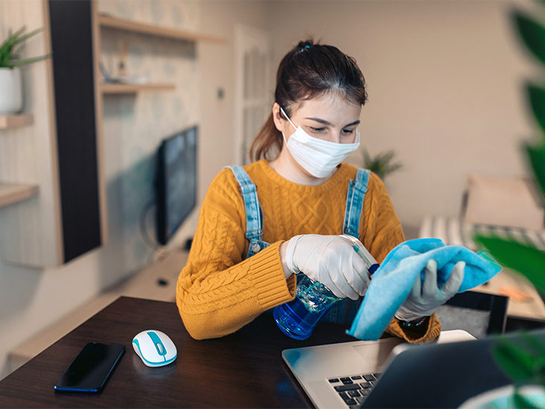
Every day, use a household cleaner or wipe to clean things that get touched a lot. These include doorknobs, light switches, toys, remote controls, sink handles, counters, and phones. Keep a sick child's toys separate from other toys, if possible.

Slide 14
Food safety
Wash the vegetables (with warm water and repeatedly)

Slide 15
Clean your kitchen before and after use

Slide 16
Keep in mind

Slide 17
To protect others in your community:
The person who is sick should stay home unless they need medical care.
Other household members also should stay home. If you must go out of the house, wear a cloth face covering or face mask and keep at least 6 feet (2 meters) of distance between you and other people.
Tell other people who were around the sick person. Your local or state health department can help you if you aren't sure who to notify.

Slide 18
Coping with stress during the 2019-nCoV outbreak
It is normal to feel sad, stressed, confused, scared or angry during a crisis.
Talking to people you trust can help. Contact your friends and family

Slide 19
Draw on skills you have used in the past that have helped you to manage previous life’s adversities and use those skills to help you manage your emotions during the challenging time of this outbreak.

Slide 20
Get the facts. Gather information that will help you accurately determine your risk so that you can take reasonable precautions. Find a credible source you can trust such as WHO website or, a local or state public health agency

Slide 21
Limit worry and agitation by lessening the time you and your family spend watching or listening to media coverage that you perceive as upsetting.

Slide 22
Thank you

