Slide 1
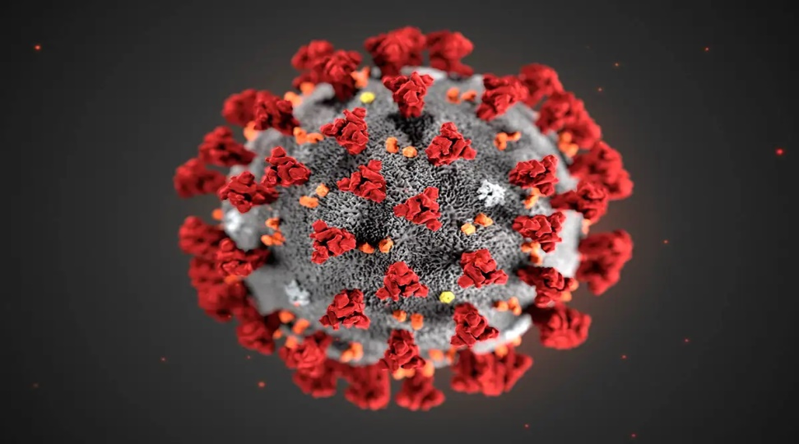
PREVENTION OF COVID 19 (HOSPITAL SETTING)

Slide 2
IPC strategies to prevent or limit transmission in health care settings

Slide 3
Ensuring triage, early recognition, and source control
Applying standard precautions for all patients
Implementing administrative controls
Using environmental and engineering controls

Slide 4
Ensuring triage, early recognition and source control

Slide 5
Managing ill Patients Seeking Care
Admit patients to dedicated area
Specific case and clinical management protocols
Safe transport and discharge home
Timely and effective triage and infection control
Admit
Safe transport and discharge home
Specific management protocols

Slide 6
TRIAGE
Prevent overcrowding
Conduct rapid triage
Family members should wait outside the triage area
Ask patients with respiratory symptoms to wear face mask, follow respiratory and hand hygiene
Ensure at least 1 m distance between patients
Maintain a one way flow of patients and staff

Slide 7
HOSPITAL ADMISSION AND PATIENT PLACEMENT
Place patients with COVID-19 infection in single well ventilated room when possible.
If single isolation rooms not possible
Keep patients in well ventilated wards
Cohort patients with the same diagnosis in one area/ward
Assign trained and experienced healthcare workers.

Slide 9
Applying standard precautions

Slide 10
ELEMENTS OF STANDARD PRECAUTIONS
Hand hygiene
Respiratory hygiene (cough etiquette)
PPE according to the risk
Safe injection practices, sharps management and injury prevention
Cleaning and disinfection of patient care equipment
Environmental cleaning
Safe handling and cleaning of soiled linen
Waste management

Slide 11
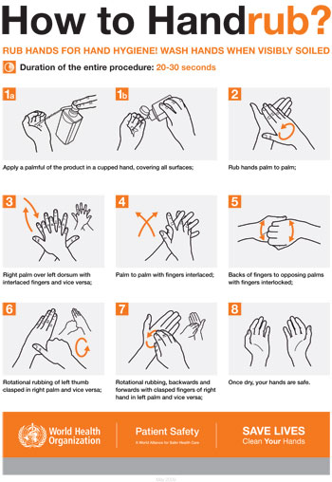
HAND AND RESPIRATORY HYGIENE

Slide 12
PPE for use in health care for COVID-19
Face Mask
N95 Mask Face shield
Goggle
Nose + mouth
Nose + mouth
Eyes + Face
Eyes
Gown
Apron
Gloves
Head cover
Shoe cover
Body
Body
Hands
Head + hair
Feet

Slide 14
Seven steps to safe injections
1 Clean work space
2 Hand hygiene
3 Sterile safety-engineered syringe
4 Sterile vial of medication and diluent
5 Skin cleaning and antisepsis
6 Appropriate collection of sharps
7 Appropriate waste management
https://www.who.int/infection-prevention/tools/injections/training-education/en/

Slide 17
CLEANING SOILED BEDDING, TOWELS AND CLOTHES FROM PATIENTS WITH COVID-19
Hospital disinfectants:
70% ethyl alcohol for small areas -reusable dedicated equipment (e.g., thermometers)
Sodium hypochlorite at 1% for surface disinfection.
Soiled linen should be placed in clearly labelled, leak-proof bags or containers, carefully removing any solid excrement and putting in covered bucket to dispose of in the toilet

Slide 18
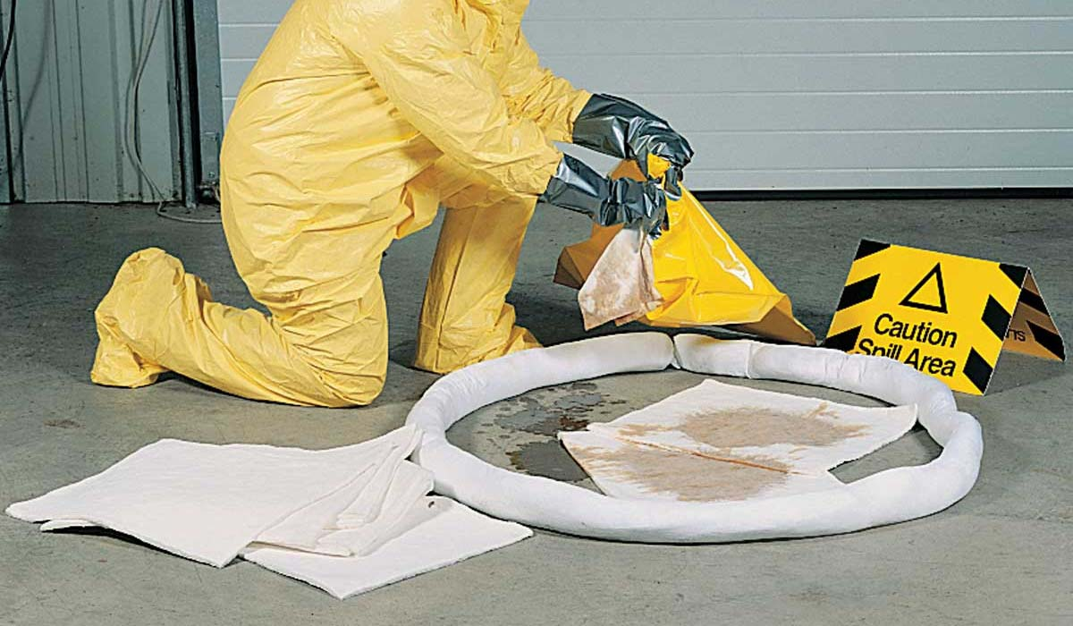
SPILL MANAGEMENT
Use disinfectant: hypochlorite
1% for small spills
10% for large spills

Slide 19
PREVENTION OF INFECTION IN HOSPITAL
Patient should be in a single room.
Cohort: all patients with respiratory illness should be in a single room or minimum 1m away from other patients when for a room with droplet/contact precautions.
Natural ventilation with air flow of at least 160L/s per patient.
Negative pressure room with at least 12 air changes (ACH) per hour.

Slide 20
PREVENTION OF INFECTION IN HOSPITAL
Following respiratory hygiene measures.
Offer a medical mask to patients with suspected COVID-19 while they are in waiting/public areas.
Perform hand hygiene after contact with respiratory secretions.

Slide 21
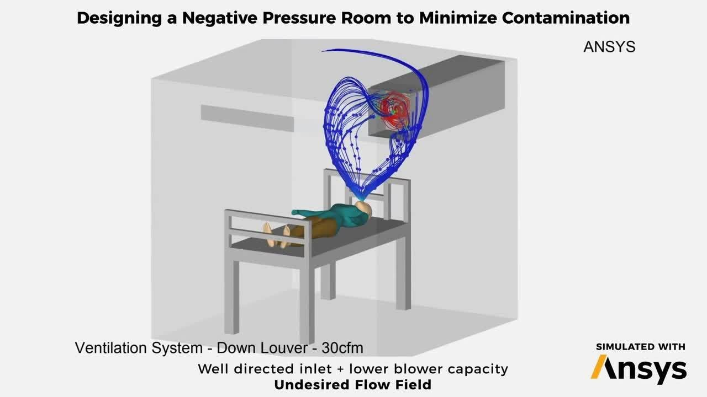
For HCW’s
Perform procedures in an adequately ventilated room or in negative- pressure rooms.

Slide 22
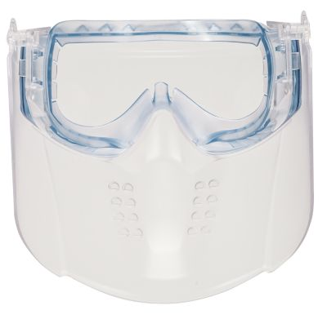
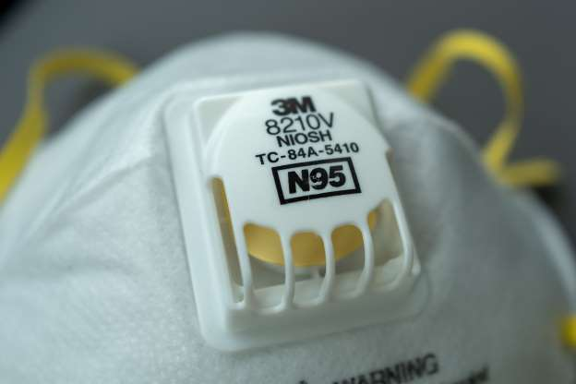
For HCW’s
Use a particulate respirator certified N95.
Use eye protection (i.e. goggles or a face shield);

Slide 23
For HCW’s
Wear a clean, non-sterile, long-sleeved gown and gloves.
If gowns are not fluid-resistant, HCWs should use a waterproof apron for procedures expected to create high volumes of fluid that might penetrate the gown.
Limit the number of persons present in the room.

Slide 24
IMPLEMENTING ADMINISTRATIVE CONTROLS
Developing policies on the early recognition of acute respiratory infection potentially caused by COVID-19 virus;
Ensuring access to prompt laboratory testing for preventing overcrowding, especially in emergency departments;
Appropriately isolating hospitalized patients.
Ensuring adequate supplies of PPE.
Provision of adequate training for HCWs.
Ensuring an adequate patient-to-staff ratio

Slide 25
USING ENVIRONMENTAL AND ENGINEERING CONTROLS
Adequate ventilation in all areas in the health care facility, as well as adequate environmental cleaning.
Separation of at least 1 metre should be maintained between all patients.
Cleaning environmental surfaces with water and detergent and applying commonly used hospital disinfectants.
Manage laundry, food service utensils and medical waste in accordance with safe routine procedures.

Slide 26
Biomedical waste management

Slide 27
Labelling of BMW bags
Label should be non-washable and prominently visible

Slide 28
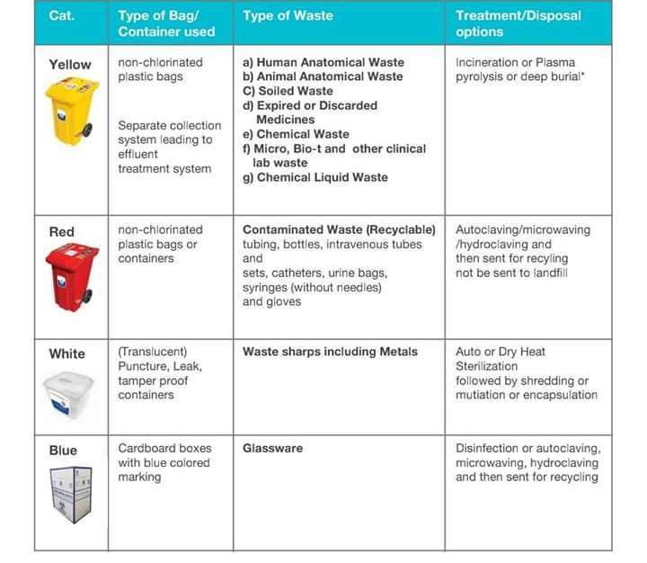

Slide 33
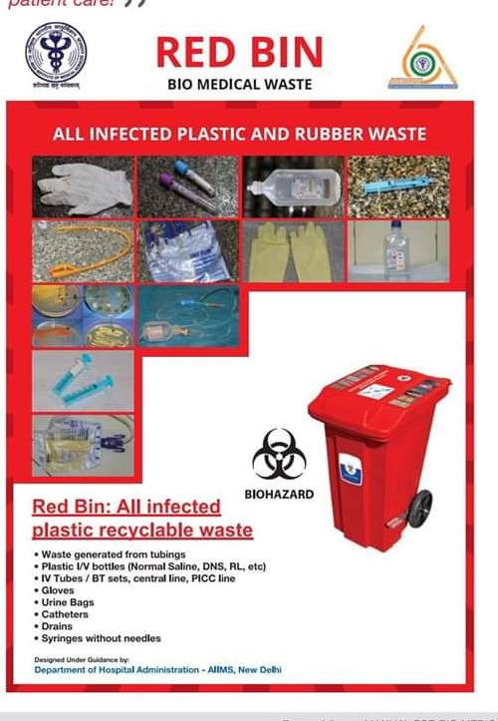

Slide 34
CONCLUSION

Slide 35
Thank you

