Slide 1
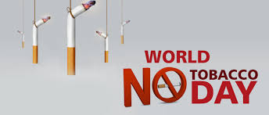
Presenter:-
Ms. Manpreet Kaur
Nursing Tutor
Akal College of Nursing
Eternal University, Baru Sahib

Slide 3
Why ‘World No Tobacco Day’ is observed?
On May 31st every year, the world observers World No Tobacco Day that is promoted by the World Health Organization (WHO).
The objectives of observing World No Tobacco Day is to reduce tobacco consumption which can lead to deadly diseases like cancer and early death.
It primarily focuses on encouraging users to refrain from Tobacco consumption and its related products.

Slide 4
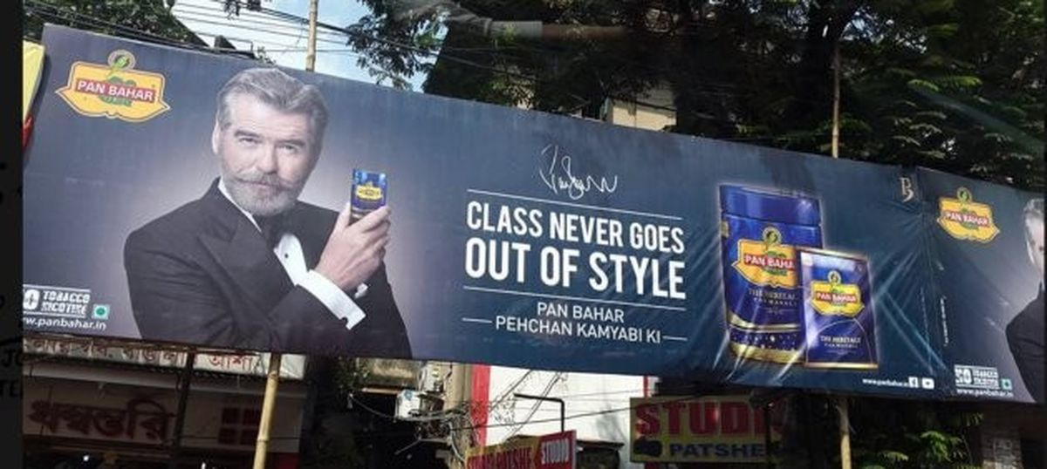
No Tobacco Day also aims to keep a watch on companies that sell cigarettes and tobacco products through striking advertisements which influence people to consume their products.

Slide 5
What is Tobacco?

Slide 6
Tobacco in India
43% of rural and 28% of urban Indian males aged 10 years and above consume tobacco and tobacco-containing products.
11% of rural and 5% of urban Indian females aged 10 and above used tobacco and tobacco-containing products.
According to the Indian Council of Medical Research(ICMR) there are 200 million active tobacco users in India.
Tobacco kills 800,000 people and 12 million become ill every year in India due to its consumption.

Slide 7
India spends approximately Rs. 300 billion annually in both public and private on treatment of tobacco related illness, accounting about one-fourth of all health spending.
Nearly 600,000 Indians die of cancer every year between the age of 30-69.

Slide 8
Various Issues on Tobacco
A National survey released by the Health ministry revealed that more than 285 million people in India use tobacco and India is fourth-largest country in Tobacco using.
More than one million Indians are estimated to die annually simply from smoking tobacco.
India has 285 million smokers and 138 million don't know that smoking cause stroke and other diseases.
According to a report released by the World Heart Federation, half of all Chinese smokers and one -third of Indian smokers are unaware of the risks related to tobacco on heart.

Slide 9
Tobacco Consumption
There are almost 267 million tobacco users in India.
Among adults (age 15+), 28.6% of the population currently uses tobacco products (male 42.4%; female 14.2%).
21.4% of adults use smokeless tobacco (male 29.6%; female 12.8%)
10.7% of adults smoke (male 19.0%; female 2.0%)
The majority of adult smokers smoke bidis (7.7% of adults overall)
Among youth (ages 13-15):
14.6% currently use some form of tobacco (boys 19.0%; girls 8.3%)
4.4% smoke cigarettes and 12.5% use other tobacco products

Slide 10
Secondhand Smoke Exposure
30.2% of adults are exposed to secondhand smoke in indoor workplaces, 7.4% are exposed in restaurants, and 13.3% are exposed in public transportation.
36.6% of youth (ages 13-15) are exposed to secondhand smoke in public places, and 21.9% are exposed at home.

Slide 11
Health Consequences
Each year tobacco use kills about one million Indians:
Smoking and exposure to secondhand smoke kill about 926,000 people each year.
Smokeless tobacco use kills an additional 200,000 people in India each year, accounting for 74% of the global burden of smokeless tobacco.
Bidi and cigarette smokers die 6 to 10 years earlier than non-smokers.
If current trends continue tobacco will account for 13% of all deaths by 2020.

Slide 12
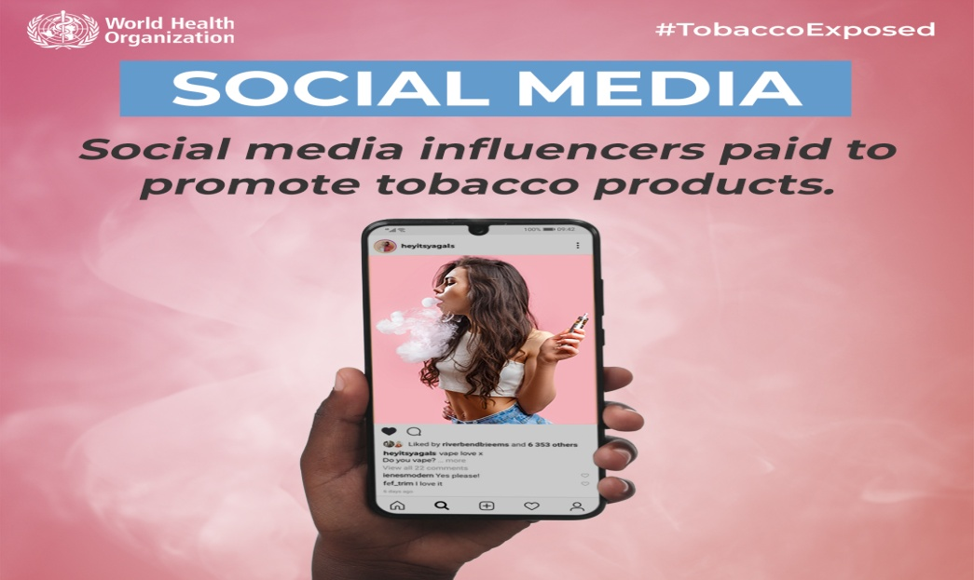
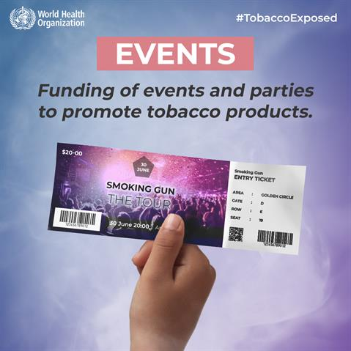
HOW TOBACCO AND RELATED INDUSTRIES ATTRCT YOUNGER GENERATIONS?
Promotion of tobacco products and the distribution of free samples at popular events for young people.
Advertising and product placement on movies and TV-shows and through social media platforms with paid influencers.

Slide 13
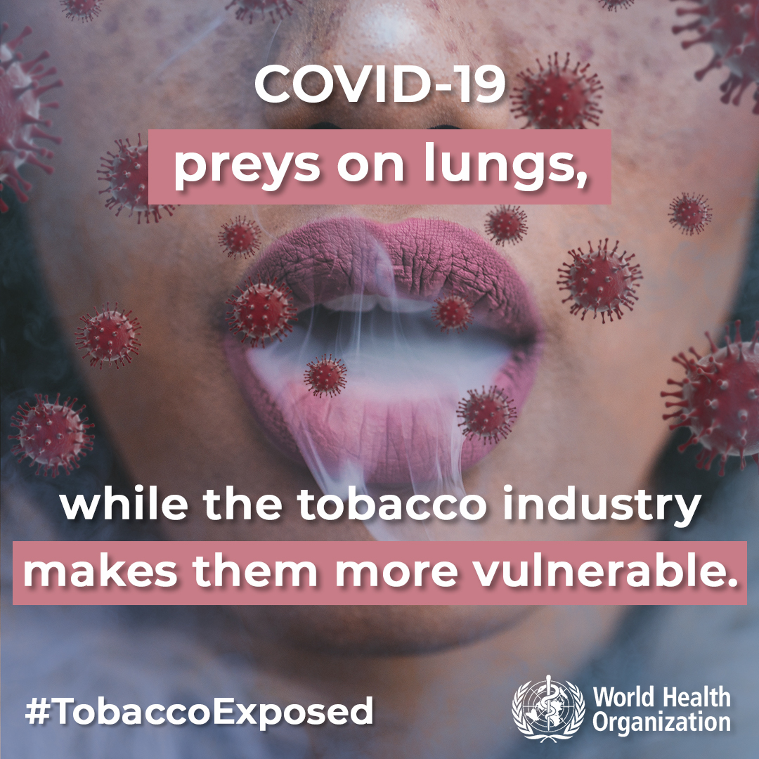

Slide 14
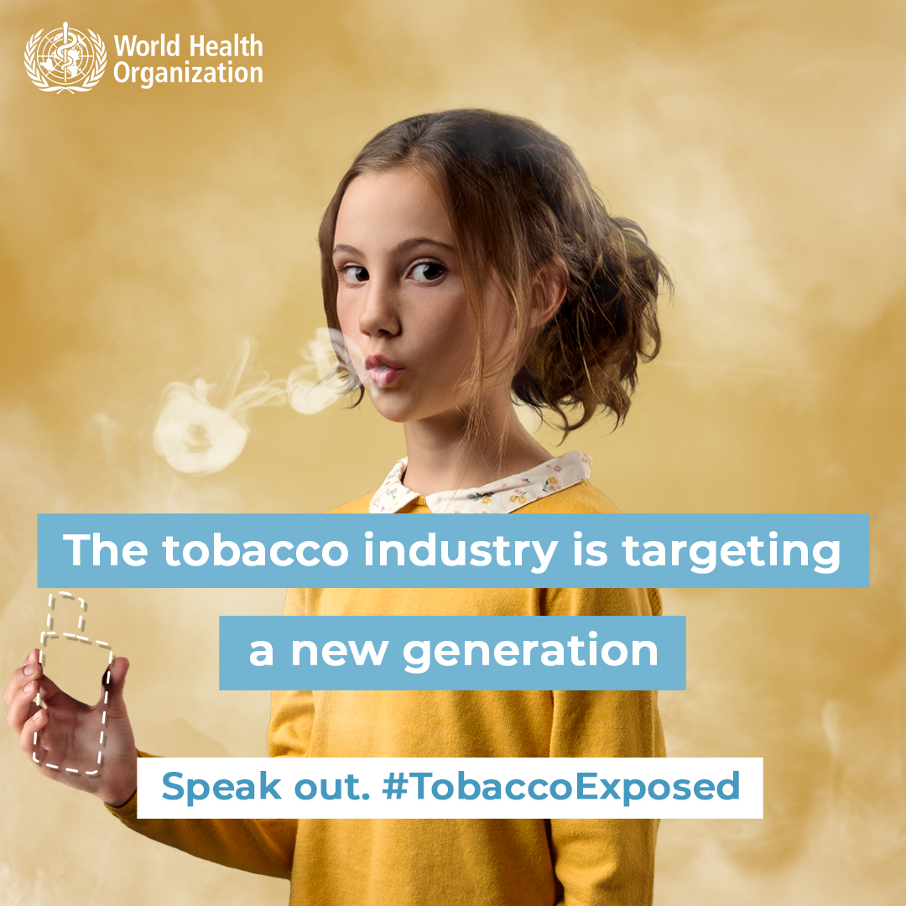

Slide 15
