Slide 1
ECOSYSTEM
PREPARED BY-
Nitasha Sharma
Clinical Instructor
ACN

Slide 2
Concept of an Ecosystem:
Living organisms cannot live isolated from their non-living environment be­cause the latter provides materials and energy for the survival of the former i.e. there is interaction between a biotic community and its environment to produce a stable system; a natural self-sufficient unit which is known as an ecosystem.

Slide 3
An ecosystem is, therefore, defined as-
A natural functional ecological unit comprising of living organisms (biotic community) and their non-living (abiotic ) environment that interact to form a stable self-supporting sys­tem.
A pond, lake, desert, grassland, meadow, forest etc. are common examples of ecosystems.

Slide 4
Structure and Function of an Ecosystem:
Each ecosystem has two main components:
(1) Abiotic
(2) Biotic

Slide 5
(1) Abiotic Components:
The non living factors or the physical environment prevailing in an ecosystem form the abiotic components. They have a strong influence on the structure, distribution, behavior and inter-relationship of organisms.

Slide 6
Abiotic components are mainly of two types
(a) Climatic Factors: Which include rain, temperature, light, wind, humidity etc.
(b) Edaphic Factors: Which include soil, pH, topography minerals etc.

Slide 7
The functions of important factors in abiotic components are
Soils are much more complex than simple sediments. They contain a mixture of weathered rock fragments, highly altered soil mineral particles, organic mat­ter, and living organisms. Soils provide nutrients, water, a home, and a struc­tural growing medium for organisms. The vegetation found growing on top of a soil is closely linked to this component of an ecosystem through nutrient cycling

Slide 8
Cont.
The atmosphere provides organisms found within ecosystems with carbon di­oxide for photosynthesis and oxygen for respiration. The processes of evapora­tion, transpiration and precipitation cycle water between the atmosphere and the Earth’s surface.

Slide 9
Cont.
Solar radiation is used in ecosystems to heat the atmosphere and to evapo­rate and transpire water into the atmosphere. Sunlight is also necessary for photosynthesis. Photosynthesis provides the energy for plant growth and me­tabolism, and the organic food for other forms of life.

Slide 10
Cont.
Water is the medium by which mineral nutrients enter and are trans-located in plants. It is also necessary for the maintenance of leaf turgidity and is required for photosynthetic chemical reactions. Plants and animals receive their water from the Earth’s surface and soil. The original source of this water is precipita­tion from the atmosphere.

Slide 11
(2) Biotic Components
:
The living organisms including plants, animals and micro-organisms (Bacteria and Fungi) that are present in an ecosystem form the biotic components.

Slide 12
On the basis of their role in the ecosystem the biotic components can be classi­fied into three main groups:
(A) Producers
(B) Consumers
(C) Decomposers or Reducers.

Slide 13
(A) Producers:
The green plants have chlorophyll with the help of which they trap solar energy and change it into chemical energy of carbohydrates using simple inorganic compounds namely water and carbon dioxide. This process is known as photo­synthesis. As the green plants manufacture their own food they are known as Autotrophs (i.e. auto = self, trophos = feeder)
The chemical energy stored by the producers is utilised partly by the producers for their own growth and survival and the remaining is stored in the plant parts for their future use.

Slide 14
(B) Consumers:
The animals lack chlorophyll and are unable to synthesise their own food. There­fore, they depend on the producers for their food. They are known as heterotrophs (i.e. heteros = other, trophos = feeder)

Slide 15
The consumers are of four types, namely:
(a) Primary Consumers or First Order Consumers or Herbivores
(b) Secondary Consumers or Second Order Consumers or Primary Carnivores
(c) Tertiary Consumers or Third Order Consumers
(d) Quaternary Consumers or Fourth Order Consumers or Omnivores

Slide 16
(a) Primary Consumers or First Order Consumers or Herbivores:
These are the animals which feed on plants or the producers. They are called her­bivores. Examples are rabbit, deer, goat, cattle etc.

Slide 17
(b) Secondary Consumers or Second Order Consumers or Primary Carnivores:
The animals which feed on the herbivores are called the pri­mary carnivores. Examples are cats, foxes, snakes etc.

Slide 18
(c) Tertiary Consumers or Third Order Consumers:
These are the large carnivores which feed on the secondary consumers. Example are Wolves.

Slide 19
(d) Quaternary Consumers or Fourth Order Consumers or Omnivores
:
These are the largest carnivores which feed on the tertiary consumers and are not eaten up by any other animal. Examples are lions and tigers

Slide 20
(C) Decomposers or Reducers:
Bacteria and fungi belong to this category. They breakdown the dead organic materials of producers (plants) and consumers (animals) for their food and re­lease to the environment the simple inorganic and organic substances produced as by-products of their metabolisms.

Slide 21
Cont.
These simple substances are reused by the producers resulting in a cyclic ex­change of materials between the biotic community and the abiotic environment of the ecosystem. The decomposers are known as Saprotrophs (i.e., sapros = rotten, trophos = feeder)

Slide 22
Energy Flow In Ecosystem
Every ecosystem has several interrelated mechanisms that affect human life.
These are-
Water cycle
Carbon cycle
Oxygen cycle
Nitrogen cycle
Energy cycle.

Slide 23
Cont.
While every ecosystem is controlled by these cycles, in each ecosystem its abiotic and biotic features are distinct from each other. All the functions of the ecosystem are in some way related to the growth and regeneration of its plant and animal species. These linked processes can be depicted as the various cycles. These processes depend on energy from sunlight

Slide 24
Cont.
During photosynthesis carbon dioxide is taken up by plants and oxygen is released. Animals depend on this oxygen for their respiration.
The water cycle depends on the rainfall, which is necessary for plants and animals to live.

Slide 25
Cont.
The energy cycle recycles nutrients into the soil on which plant life grows.
Our own lives are closely linked to the proper functioning of these cycles of life. If human activities go on altering them, humanity cannot survive on our earth.

Slide 26
The Water Cycle
When it rains, the water runs along the ground and flows into rivers or falls directly into the sea.
A part of the rainwater that falls on land percolates into the ground. This is stored underground throughout the rest of the year.
Water is drawn up from the ground by plants along with the nutrients from the soil. The water is transpired from the leaves as water vapour and returned to the atmosphere

Slide 27
Cont.
As it is lighter than air, water vapour rises and forms clouds. Winds blow the clouds for long distances and when the clouds rise higher, the vapour condenses and changes into droplets, which fall on the land as rain.
Though this is an endless cycle on which life depends, man’s activities are making drastic changes in the atmosphere through pollution which is altering rainfall patterns. This is leading to prolonged drought periods extending over years in countries such as Africa, while causing floods in countries such as the US.

Slide 28
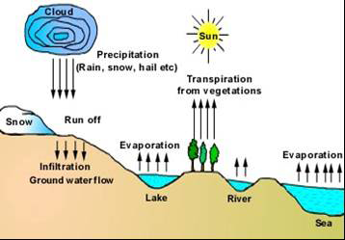

Slide 29
The Carbon cycle
The carbon, which occurs in organic compounds, is included in both the abiotic and biotic parts of the ecosystem. Carbon is a building block of both plant and animal tissues
In the atmosphere, carbon occurs as carbon dioxide (CO2). In the presence of sunlight, plants take up carbon dioxide from the atmosphere through their leaves. The plants combine carbon dioxide with water, which is absorbed by their roots from the soil. In the presence of sunlight they are able to form carbohydrates that contain carbon. This process is known as photosynthesis.

Slide 30
Cont.
Plants use this complex mechanism for their growth and development. In this process, plants release oxygen into the atmosphere on which animals depend for their respiration. Plants therefore help in regulating and monitoring the percentage of Oxygen and Carbon dioxide in the earth’s atmosphere.

Slide 31
Cont.
All of mankind thus depends on the oxygen generated through this cycle. It also keeps the CO2 at acceptable levels
Herbivorous animals feed on plant material, which is used by them for energy and for their growth. Both plants and animals release carbon dioxide during respiration. They also return fixed carbon to the soil in the waste they excrete. When plants and animals die they return their carbon to the soil. These processes complete the carbon cycle.

Slide 32
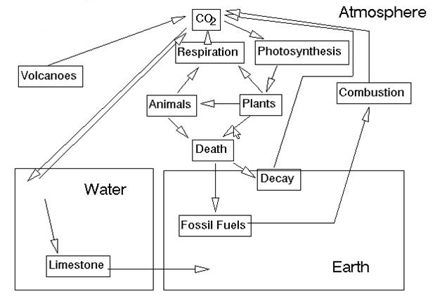

Slide 33
The Nitrogen Cycle
Carnivorous animals feed on herbivorous animals that live on plants. When animals defecate, this waste material is broken down by worms and insects mostly beetles and ants
These small ‘soil animals’ break the waste material into smaller bits on which microscopic bacteria and fungi can act.
This material is thus broken down further into nutrients that plants can absorb and use for their growth. Thus nutrients are recycled back from animals to plants.

Slide 34
Cont.
Similarly the bodies of dead animals are also broken down into nutrients that are used by the plants for their growth. Thus the nitrogen cycle on which life is dependent is completed.
Nitrogen fixing bacteria and fungi in soil gives this important element to plants, which absorb it as nitrates. The nitrates are a part of the plant’s metabolism, which help in forming new plant proteins

Slide 35
Cont.
The nitrogen is then transferred to carnivorous animals when they feed on the herbivores. Thus our own lives are closely interlinked to soil animals, fungi and even bacteria in the soil. When we think of food webs, we usually think of the large mammals and other large forms of life.
But we need to understand that it is the unseen small animals, plants and microscopic forms of life that are of great value for the functioning of the ecosystem.

Slide 37
Oxygen Cycle
Oxygen is taken up by plants and animals from the air during respiration. The plants return oxygen to the atmosphere during photosynthesis. This links the Oxygen Cycle to the Carbon Cycle
Deforestation is likely to gradually reduce the oxygen levels in our atmosphere. Thus plant life plays an important role in our lives which we frequently do not appreciate. This is an important reason to participate in afforestation programs.

Slide 38
Cont.
When we think of food webs, we usually think of the large mammals and other large forms of life. But we need to understand that it is the unseen small animals, plants and microscopic forms of life that are of great value for the functioning of the ecosystem.

Slide 39
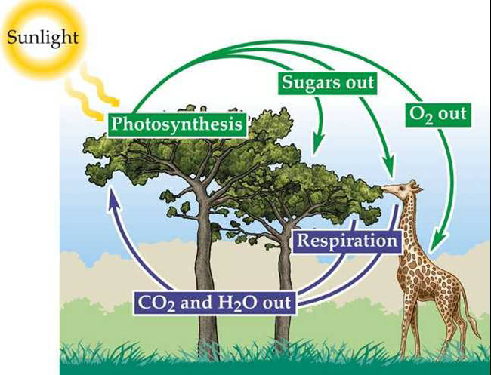

Slide 40
The Energy Cycle
The energy cycle is based on the flow of energy through the ecosystem. Energy from sunlight is converted by plants themselves into growing new plant material which includes leaves, flowers, fruit, branches, trunks and roots of plants. Since plants can grow by converting the sun’s energy directly into their tissues, they are known as producers in the ecosystem.

Slide 41
Cont.
A large part of this energy is used up for day to day functions of these animals such as breathing, digesting food, supporting growth of tissues, maintaining blood flow and body temperature. Energy is also used for activities such as looking for food, finding shelter, breeding and bringing up young ones.

Slide 42
Cont.
The carnivores in turn depend on herbivorous animals on which they feed. Thus the different plant and animal species are linked to one another through food chains. Each food chain has three or four links.
However as each plant or animal can be linked to several other plants or animals through many different linkages, these inter-linked chains can be depicted as a complex food web.
This is thus called the ‘web of life’ that shows that there are thousands of interrelationships in nature.

Slide 43
Energy Pyramid
The energy in the ecosystem can be depicted in the form of a food pyramid or energy pyramid. The food pyramid has a large base of plants called ‘producers’.
The pyramid has a narrower middle section that depicts the number and biomass of herbivorous animals, which are called ‘first order consumers’

Slide 44
Cont.
The apex depicts the small biomass of carnivorous animals called ‘second order consumers’. Man is one of the animals at the apex of the pyramid.
Thus to support Animals excrete waste products after digesting food, which goes back to the soil. This links the energy cycle to the Nitrogen cycle.

Slide 45
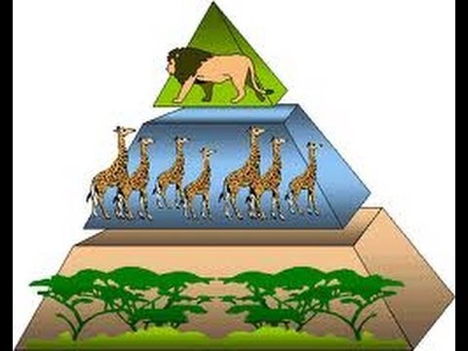

Slide 46
Integration of cycles in Nature
These cycles are a part of global life processes. These biogeochemical cycles have specific features in each of the ecosystems. These cycles are however linked to those of adjacent ecosystems. Their characteristics are specific to the plant and animal communities in the region. This is related to the geographical features of thearea, the climate and the chemical composition of the soil. Together the cycles are responsible for maintaining life on earth. If mankind disturbs these cycles beyond the limits that nature can sustain, they will eventually break down and lead to a degraded earth on which man will not be able to survive.

Slide 47
ECOLOGICAL SUCCESSION
Ecological succession is a process through which ecosystems tend to change over a period of time.
Succession can be related to seasonal environmental changes, which create changes in the community of plants and animals living in the ecosystem.
Other successional events may take much longer periods of time extending to several decades

Slide 48
Cont.
If a forest is cleared, it is initially colonized by a certain group of species of plants and animals, which gradually change through an orderly process of community development. One can predict that an opened up area will gradually be converted into grassland, a shrub land and finally a woodland and a forest if permitted to do so without human interference. There is a tendency for succession to produce a more or less stable state at the end of the successional stages.

Slide 49
Developmental stages in the ecosystem thus consist of a pioneer stage, a series of changes known as serial stages, and finally a climax stage. The successive stages are related to the way in which energy flows through the biological system.

Slide 50
Cont.
The most frequent example of successional changes occur in a pond ecosystem where it fluctuates from a dry terrestrial habitat to the early colonisation stage by small aquatic species after the monsoon, which gradually passes through to a mature aquatic ecosystem, and then reverts back to its dry stage in summer where its aquatic life remains dormant.

Slide 51
FOOD CHAINS, FOOD WEBS AND ECOLOGICAL PYRAMIDS
The transfer of energy from the source in plants through a series of organisms by eating and being eaten constitutes food chains.
At each transfer, a large proportion of energy is lost in the form of heat. These food chains are not isolated sequences, but are interconnected with each other.
This interlocking pattern is known as the food web.
Each step of the food web is called a trophic level.
Hence green plants occupy the first level, herbivores the second level, carnivores the third level and secondary carnivores the fourth level. These trophic levels together form the ecological pyramid.

Slide 52
The food chains
The most obvious aspect of nature is that energy must pass from one living organism to another. When herbivorous animals feed on plants, energy is transferred from plants to animals.
In an ecosystem, some of the animals feed on other living organisms, while some feed on dead organic matter.
The latter form the ‘detritus’ food chain

Slide 53
Cont.
At each linkage in the chain, a major part of the energy from the food is lost for daily activities. Each chain usually has only four to five such links.
However a single species may be linked to a large number of species mankind, there must be a large base of herbivorous animals and an even greater quantity of plant material.
When plants and animals die, this material is returned to the soil after being broken down into simpler substances by decomposers such as insects, worms, bacteria and fungi so that plants can absorb the nutrients through their root

Slide 54
The food webs
In an ecosystem there are a very large number of interlinked chains. This forms a food web.
If the linkages in the chains that make up the web of life are disrupted due to human activities that lead to the loss of species, the web breaks down.

Slide 55
The ecological pyramids
In an ecosystem, green plants – the producers, utilize energy directly from sunlight and convert it into matter. A large number of these organisms form the most basic, or first ‘trophic level’ of the food pyramid. The herbivorous animals that eat plants are at the second trophic level and are called primary consumers. The predators that feed on them form the third trophic level and are known as secondary consumers. Only a few animals form the third trophic level consisting of carnivores at the apex of the food pyramid. This is how energy is used by living creatures and flows through the ecosystem from its base to the apex. Much of the energy is used up in activities of each living organism

Slide 56
Types of Ecosystems-
Terrestrial Ecosystems | Aquatic Ecosystems
Forest | Pond
Grassland | Lake
Semi arid areas | Wetland
Deserts | River
Mountains | Delta
Islands | Marine

Slide 57
Forest ecosystem
Forests are formed by a community of plants which is predominantly structurally defined by its trees, shrubs, climbers and ground cover. Natural vegetation looks vastly different from a group of planted trees, which are in orderly rows. The most ‘natural’ undisturbed forests are located mainly in our National Parks and Wildlife Sanctuaries.

Slide 58
The forest ecosystem has two parts:
The non-living or abiotic aspects of the forest
The living or the biotic aspects of the forest

Slide 59
The non-living or abiotic aspects of the forest:
• The type of forest depends upon the abiotic conditions at the site.
Forests on mountains and hills differ from those along river valleys. Vegetation is specific to the amount of rainfall and the local temperature which varies according to latitude and altitude. Forests also vary in their plant communities in response to the type of soil.

Slide 60
The living or the biotic aspects of the forest:
The plants and animals form communities that are specific to each forest type. For instance coniferous trees occur in the Himalayas. Mangrove trees occur in river deltas. Thorn trees grow in arid areas. The snow leopard lives in the Himalayas while the leopard and tiger live in the forests of the rest of India. Wild sheep and goats live high up in the Himalayas. Many of the birds of the Himalayan forests are different from the rest of India. Evergreen forests of the Western Ghats and North East India are most rich in plant and animal species.

Slide 61
Cont.
The biotic component includes both the large (macrophytes) and the microscopic plants and animals. Plants include the trees, shrubs, climbers, grasses, and herbs in the forest. The animals include species of mammals, birds, reptiles, amphibians, fish, insects and other invertebrates and a variety of microscopic animals.

Slide 62
Cont.
As the plant and animal species are closely dependent on each other, together they form different types of forest communities.
Man is a part of these forest ecosystems and the local people depend directly on the forest for several natural resources that act as their life support systems. People who do not live in the forest buy forest products such as wood and paper, which has been extracted from the forest. Thus they use forest produce indirectly from the market.

Slide 63
Forest types in India:
The forest type depends upon the abiotic factors such as climate and soil characteristics of a region.
Forests in India can be broadly divided into Coniferous forests and Broadleaved forests.
They can also be classified according to the natureof their tree species – evergreen, deciduous, xerophytic or thorn trees, mangroves, etc. They can also be classified according to the most abundant species of trees such as Sal or Teak forests.

Slide 64
Forest utilisation
Direct uses of forest products-
Fruits – mango, jamun, awla
Roots – Dioscoria
Medicine – Gloriosa, Foxglove
Fuel wood – many species of trees and shrubs
Small timber for building huts and houses
Wood for farm implements
Bamboo and cane for baskets
Grass for grazing and stall feeding livestock

Slide 65
Indirect uses of forest products
Building material for construction and furniture for the urban sector
Medicinal products collected and processed into drugs
Gums and resins processed into a variety of products
Raw material for industrial products and chemicals
Paper from bamboo and softwoods

Slide 66
Grassland ecosystems
A wide range of landscapes in which the vegetation is mainly formed by grasses and small annual plants are adapted to India’s various climatic conditions. These form a variety of grassland ecosystems with their specific plants and animals.

Slide 67
What is a grassland ecosystem?
Grasslands cover areas where rainfall is usually low and/or the soil depth and quality is poor. The low rainfall prevents the growth of a large number of trees and shrubs, but is sufficient to support the growth of grass cover during the monsoon. Many of the grasses and other small herbs become dry and the part above the ground dies during the summer months. In the next monsoon the grass cover grows back from the root stock and the seeds of the previous year. This change gives grasslands a highly seasonal appearance with periods of increased growth followed by a dormant phase.

Slide 68
Grassland Types in India:
Grasslands form a variety of ecosystems that are located in different climatic conditions ranging from near desert conditions, to patches of shola grasslands thatoccur on hillslopes alongside the extremely moist evergreen forests in South India.
In the Himalayan mountains there are the high cold Himalayan pastures. There are tracts of tall elephant grass in the low-lying Terai belt south of the Himalayan foothills. There are semi-arid grasslands in Western India, parts of Central India,and in the Deccan Plateau

Slide 69
How are grasslands used?
Grasslands are the grazing areas of many rural communities. Farmers who keep cattle or goats, as well as shepherds who keep sheep, are highly dependent on grasslands. Domestic animals are grazed in the ‘common’ land of the village. Fodder is collected and stored to feed cattle when there is no grass left for them to graze in summer. Grass is also used to thatch houses and farm sheds.
The thorny bushes and branches of the few trees that are seen in grasslands are used as a major source of fuel wood.

Slide 70
Desert ecosystem
Desert and semi arid lands are highly specialised and sensitive ecosystems that are easily destroyed by human activities. The species of these dry areas can live only in this specialised habitat.

Slide 71
What is a desert or a semi-arid ecosystem?
Deserts and semi arid areas are located in Western India and the Deccan Plateau. The climate in these vast tracts is extremely dry. There are also cold deserts such as in Ladakh, which are located in the high plateaus of the Himalayas. The most typical desert landscape that is seen in Rajasthan is in the Thar Desert. This has sand dunes. There are also areas covered with sparse grasses and a few shrubs, which grow if it rains

Slide 72
Aquatic ecosystems
The aquatic ecosystems constitute the marine environments of the seas and the fresh water systems in lakes, rivers, ponds and wetlands. These ecosystems provide human beings with a wealth of natural resources. They provide goods that people collect for food such as fish

Slide 73
Cont.
Natural aquatic systems such as rivers and seas break down chemical and organic wastes created by man. However, this function has limitations, as the aquatic ecosystem cannot handle great quantities of waste. Beyond a certain limit, pollution destroys this natural function. If aquatic ecosystems are misused or over utilized, their ability to provide resources suffers inthe long term.

Slide 74
What is an aquatic ecosystem?
In aquatic ecosystems, plants and animals live in water. These species are adapted to live in different types of aquatic habitats. The special abiotic features are its physical aspects such as the quality of the water, which includes its clarity, salinity, oxygen content and rate of flow.
Aquatic ecosystems may be classified as being stagnant ecosystems, or running water ecosystems.

Slide 75
Aquatic ecosystems
The mud gravel or rocks that form the bed of the aquatic ecosystem alter its characteristics and influence its plant and animal species composition.
The aquatic ecosystems are classified into –
Freshwater
Brackish
Marine ecosystems
which are based on the salinity levels.

Slide 76
Cont.
The fresh water ecosystems-That have running water are streams and rivers.
Marine ecosystems are highly saline.
Brackish areas have less saline water such as in river deltas

Slide 77
What are the threats to aquatic ecosystems?
Water pollution occurs from sewage and poorly managed solid waste in urban areas when it enters the aquatic ecosystem of lakes and rivers. Sewage leads to a process called eutrophication, which destroys life in the water as the oxygen content is severely reduced. Fishes cannot breathe and are killed. A foul odour is produced.

Slide 78
Cont.
Gradually the natural flora and fauna of the aquatic ecosystem is destroyed.
In rural areas the excessive use of fertilisers causes an increase in nutrients, which leads to eutrophication(excessive richness of nutrients in a lake or other body of water)

Slide 79
Cont.
Pesticides used in adjacent fields pollute water and kills off its aquatic animals.
Chemical pollution from industry kills a large number of life forms in adjacent aquatic ecosystems

