Slide 1
JOURNAL CLUB PRESENTATION
PRESENTED ON
PRESENTER
Lovepreet Kaur
MSc(N) 2nd year
BSMHNS007
Medical Surgical Nursing

Slide 2
Effectiveness of Communication board on the Communication Pattern and level of Satisfaction among Mechanically Ventilated Patients
Author Name: Sasmita Das, Binu xavier, Farzana Begum
Journal Name: International Journal of Nursing Education and Research
Volume: 3
Year:2015

Slide 3
Introduction
Critically ill patients often have their usual means of communication interrupted or limited, either mechanically by endotracheal intubation or by the effect of drugs, at a time when the need for the information and expression of anxieties is great. Deficiency in communication ranks as one of the most negative experiences in the studies of perception of intubated patients. Patients receiving mechanical ventilation experienced a moderate to a high level of frustration when communicating their needs. In this study, a communication board, if used patiently during mechanical ventilation, frustration with communication may be alleviated .

Slide 4
The study will gauge patients' opinion on communication Board, a light, flexible communication board that will be prepared so that the patient can easily inform the caregiver of all of his or her conceivable needs. This study will describe the communication pattern and level of satisfaction experienced by the mechanically ventilated patients and ascertains the helpfulness of methods used by health care practitioners to meet the communication needs of the mechanically ventilated patients. This study will add to the body of knowledge regarding communication in mechanically ventilated patients by reporting the effectiveness of communication board on communication pattern and level of satisfaction.

Slide 5
Background of the Study
Berrouschot J.et.al (2000) have suggested that neurological, particularly cerebrovascular, patients requiring mechanical ventilation have a very bad prognosis and questioned the usefulness of such ventilation. Rabinstein AA.et.al (2004) indicated that a considerable part of these even long-term ventilated patients can have a good outcome.
John Durham Peters (1999) made a systematic review of the literature to assess the difficulties and stresses of mechanically ventilated patients in the intensive care unit (ICU) when trying to communicate with doctors and nurses. The study revealed that critical care nurses rarely receive training in effective communication with non-verbal patients, and most are unfamiliar with augmentative communication methods.

Slide 6
Katja Laksoo, (2011) conducted a study to assess the patient satisfaction in hospital among post operative patients However, many patients complained that they were not treated with respect by caregivers, did not receive adequate pain medication after surgery, and did not understand the instructions they received for home care once they left the hospital. The author claimed that poor communication was a major source of medical errors, encouraging doctors and nurses to listen more carefully to their patients.
S. Ali and Z. Kabir, (2007) conducted a study to assess the patient experiences of communication problem during ventilator treatment. A descriptive approach was used and samples are consecutive patients treated in ICCU and structured questionnaire methods are used to collect data. The result suggest that the need for detailed examination of patients potential for effective communication, evaluation of the communication skills of the nurses and further investigations of devices that can help facilitate communication between nurses and patients during ventilator.

Slide 7
Objectives of the Study
To assess the communication pattern among the patients with mechanical ventilator before and after use of communication board.
To assess the level of satisfaction among the patients with mechanical ventilator before and after use of communication board.
To compare the a) communication pattern before and after use of communication board b) level of satisfaction before and after use of communication board
4. To Correlate the communication pattern with the level of satisfaction before and after use of communication board among the patients with mechanical ventilator

Slide 8
RESEARCH METHODOLOGY
Research design : Evaluative approach and pre experimental one group pre test and post test design
Population: conscious patients with mechanical ventilator support.
Setting: ICU, SUM Hospital, Kalinga Nagar, Bhubaneswar, Orissa
Sample size: 60 ICU patients
Sampling technique: non probability purposive sampling technique is used to collect the data.

Slide 9
Inclusive criteria
➢ The adult hospitalized patients of age group>18yrs on mechanical ventilator on conscious
➢ The patient who are present at the time of visit
➢ The patient who are willing to participate in the study
➢ The patient who speak Oriya, Hindi and English

Slide 10
Exclusion criteria
➢ The adult hospitalized patients of age group<18yrs on mechanical ventilator
➢ The patient who are not willing to participate in the study
➢ The patient who doesn’t speak Oriya, Hindi and English

Slide 11
Description of data collection instruments
SECTION-A (Socio-Demographic data)
This section compromises of 9 items on socio-demographic profile that includes: age, sex, marital status, type of family, educational status, occupation, monthly income, area of resident, and duration of ventilatory support.
SECTION-B (Self-Structured rating scale to assess communication pattern)
Deals with self structured questionnaire to assess the communication pattern of patients on ventilator that contains rating scale, each having 3 options.
Responses which occurred always scored 3, responses which occurred sometime scored 2, and responses which occurred never scored 1.

Slide 12
SECTION-C (Self-Structured rating scale to assess level of satisfaction) Deals with self structured questionnaire to assess the level of satisfaction of patients on ventilator that contains rating scale, each having 3 options. Responses which occurred never scored 3, responses which occurred sometime scored 2, and responses which occurred often scored 1.

Slide 13
Ethical considerations
The research problem and objectives where approved by the research committee. Due permission from the authorities has been soughed and obtained. Informed written consent was obtained from all the patients who were on invasive ventilator support in the ICU of IMS and SUM Hospital, Bhubaneswar. Explanation was given regarding the purpose of the study and confidentiality and anonymity was ensured

Slide 14
TABLE-1: Description of patients on mechanical ventilator according to socio demographic variables
Sl. No. | Sample | Characteristics | Frequency (f) | Percentage (%)
1. | Age | 21-30 31-40 41-50 >50 | 18 18 15 09 | 30 30 25 15
2. | Gender | Male Female | 37 23 | 62 38
3. | Marital status | Married Unmarried Divorce Widow | 51 09 00 00 | 85 15 00 00
4. | Educational status | Illiterate Primary/high school Under graduate Graduate and above | 00 19 26 15 | 00 32 43 25

Slide 15
S.no | Sample | Characteristics | Frequency (f) | Percentage (%)
5. | Family type | Nuclear Joint Extended | 22 31 07 | 36 52 12
6. | Occupation | Business Govt. sector Private sector Other | 22 10 13 15 | 36 17 22 25
7. | Monthly income | <5000 5,000-10,000 10,000-15,000 >15,000 | 03 21 14 22 | 05 35 23 37
8. | Residential status | Rural Urban Slum | 22 38 00 | 37 63 00
9. | Duration of ventilatory support (days ) | <4 4-7 >7 | 17 16 27 | 28 27 45

Slide 16
Table- 2 mean, median and standard deviation of pre test and post test communication pattern of patients with mechanical ventilator
Criteria | Total score | Mean | Median | Standard deviation
Pre test | 4731 | 78.85 | 79 | 7.16
Post test | 8064 | 134.4 | 134 | 6.68

Slide 17
Table 3 N=6
Type of test | Total mean | Mean score percentage | S.D | Variance | Z-value
Pre test | 78.85 | 50.5 | 7.16 | 51.26 | 31.2(p=<0.0001
Post test | 134.4 | 86.1 | 6.68 | 44.74
Z (59) at 0.05 significant level=2.0

Slide 18
Table- 4 : Analysis of overall communication pattern score as per criterion
Communication pattern | score | Pretest Frequency | Percentage | Posttest Frequency | Percentage
Good | 104-156 | 0 | 0 | 60 | 100
Average | 52-104 | 60 | 100 | 0 | 0
Poor | 52 | 0 | 0 | 0 | 0
Total |  | 60 | 100 | 60 | 100

Slide 19
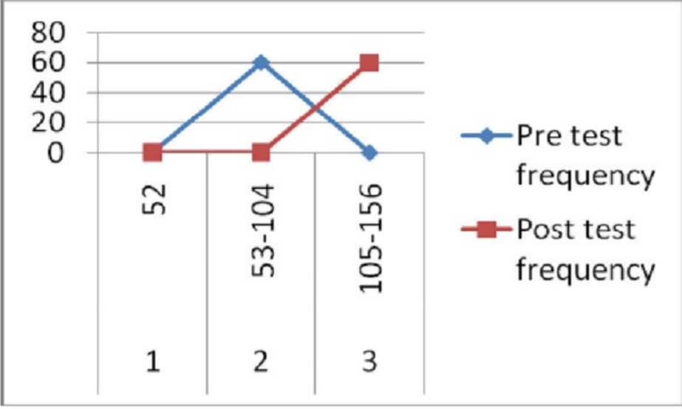
Frequency polygon on pre test and post test communication pattern score of patients with mechanical ventilator

Slide 20
CONCLUSION
The present study findings described that by using a communication board, the communication pattern and level of satisfaction can be improved. The findings conclude that the communication board developed by the researcher was found to be helpful in enhancing communication pattern and level of satisfaction of the patients with mechanical ventilator.

Slide 21
Critique of the study-
Title | Negative point | Positive point
Title of the study | They don’t mention ‘’ conscious patients” in title | Title of the study was written clearly.
Abstract |  | In abstract research design, approach, methodology and findings was mentioned properly.
Introduction |  | Introduction was clearly mentioned in the article.
Background of the study |  | In the article background of the study was written in well manner. In which review of area, current information of topic was explained.

Slide 22
Title | Negative point | Positive point
Aims/objectives | Aim of study was not mentioned . Objectives are not clearly define .
Methodology | Research approach was not mentioned . One more inclusion criteria can be included i.e GCS>8 There is no need to mention about age group <18 yrs in exclusion criteria They can also add the patients who are not heamodynamically stable in exclusion criteria | Research design, sample, setting, population, sample size was explained in the study.

Slide 23
Title | Negative points | Positive points
Result | In table 1 they have added oo value in marital status and education status Number of sample was not mentioned in table 1,2 &4 i.e N=60 In table 2 title was not clearly mentioned it can be mentioned as “comparison of pre test & post test score of communication pattern of patient Heading of table 3 was not mentioned In table-3 total population is written at the center) which should be written at the right side of the top. | Distribution of mean, median, mode and standard deviation is done.

Slide 24
Title | Negative point | Positive point
Discussion | It was not mentioned in the article
Other | Keyword was not mentioned +,- was not mentioned in the standard deviation There are lots of grammatical mistakes in the article

Slide 25
References
1. Ali, S. and Kabir, Z. Domiciliary non-invasive ventilation and the quality of life outcome of patients suffering from chronic respiratory failure. Ire Med J, 2007, 336-8.
2. Berrouschot J, Rossler A, Koster J, Schneider D. Echanical ventilation in patients with hemispheric schemic stroke. Crit Care Med 2000;28:2956-61.
3. Brooks, D., King, A., Tonack , M., Simson, H., Gould, M. and Goldstein, R.. User perspective on issues that influence the quality of daily life of ventilator-assisted individuals with neuromuscular disorders. Canadian Respiratory Journal, 2004, 547-554.
4. Burnard, P. Interpreting text: an alternative to some current forms of textual analysis in qualitative research. Social Sciences in Health, 1995, 236-245.
5. Bronwin, John, Marybeth Communication Ability, Method, and Content Among Nonspeaking: Discussion American Journal of Critical Care. 2004; 6

