Slide 1
CORONAVIRUS
PRESENTED BY: JASWINDER KAUR
ASSISTANT PROFESSOR
AKAL COLLEGE OF NURSING

Slide 2
2019-nCOV
Coronaviruses (CoV) are a large family of viruses that cause illness ranging from the common cold to more severe diseases such as Middle East Respiratory Syndrome (MERS-CoV) and Severe Acute Respiratory Syndrome (SARS-CoV). A novel coronavirus (nCoV) is a new strain that has not been previously identified in humans

Slide 3
What is a "novel" coronavirus?
A novel coronavirus (CoV) is a new strain of coronavirus that has not been previously identified in humans. The new, or “novel” coronavirus, now called 2019-nCoV, had not previously detected before the outbreak was reported in Wuhan, China in December 2019

Slide 4

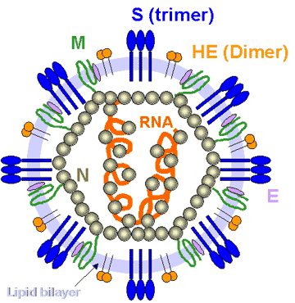
CORONAVIRUSES
The genome
- SS linear non
segmented +ve
sense RNA
- the largest among RNA
viruses.

Slide 5
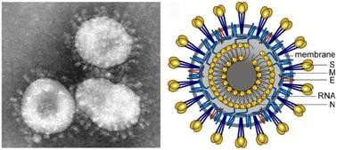
A Crown-like Appearance when viewed by EM
On the surface of the envelop are club • shaped projections that resemble a solar corona

Slide 6

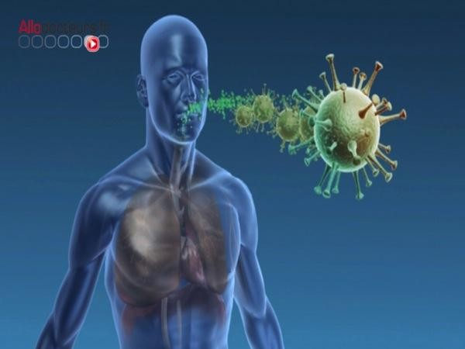
What are Corona
viruses?
Coronaviruses are believed to cause a significant percentage of all common colds in human adults. Coronaviruses cause colds in humans primarily in the winter and early spring season.
Coronaviruses primarily infect the upper respiratory and gastrointestinal tract of mammals and birds.

Slide 7
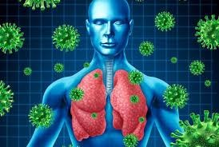
SARS Corona Virus
This has a unique pathogenesis because it causes both upper and lower respiratory tract infections and can also cause Gastroenteristis.

Slide 8

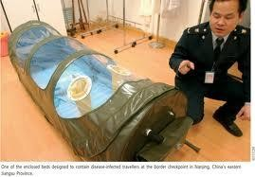
Recent History
In 2003 The SARS epidemic resulted in over 8,098 infections, about 10% (747) of which resulted in death.
Vector was Bat

Slide 9
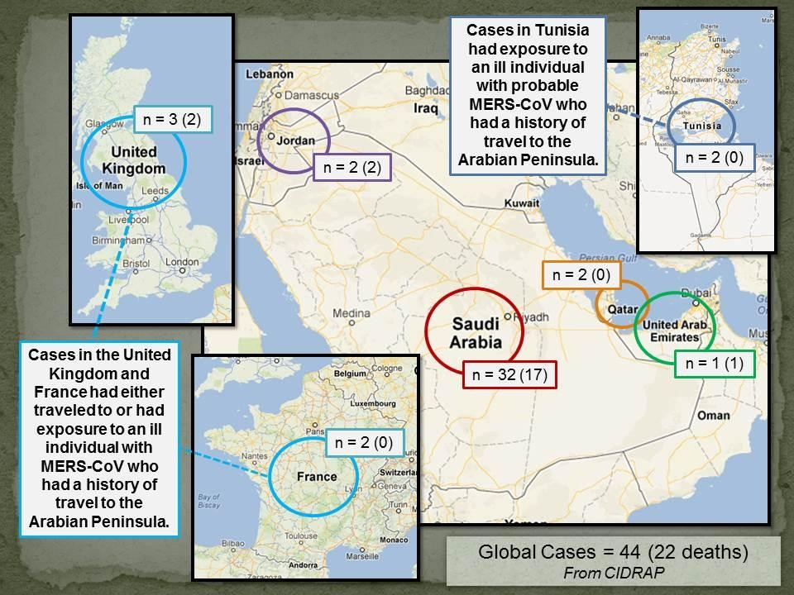
Recent History
.
In September 2012, what is believed to be a new type of coronavirus, tentatively referred to as Novel Coronavirus 2012, being like SARS (but still distinct from it and from the common- cold coronavirus) was discovered in Qatar and Saudi Arabia.

Slide 10

Middle East respiratory syndrome coronavirus (MERS-CoV)

Slide 11


World Health
Organisation
After the deadly Coronavirus outbreak killed 17 out of 33 people who contracted it in Saudi Arabia in the past year, the World Health Organization (WHO) has pledged to further investigate the disease spread before millions of Muslims descend on holy sites in Mecca and Medina during the Hajj pilgrimage season in October.

Slide 12


2013 Concerns
The Hajj pilgrimage is one of the largest mass gatherings in the world, bringing about 3 million ethnically diverse Muslims to Mecca each year, according to estimates from the Centers for Disease Control and Prevention (CDC).

Slide 13
World Health
Organisation
Globally, from September 2012 to date, WHO has been informed of a total of 1000 laboratory-confirmed cases of infection with MERS-CoV, including 400 deaths.
Vector was Camel

Slide 14

2013 Concerns
That creates a perfect opportunity for infectious diseases, especially respiratory tract infections like coronavirus, to spread. Millions of people from all over the world are gathered in tight spaces over the span of several weeks, and they take back any diseases they might have caught when they return home.

Slide 15
How is novel coronavirus transmitted ?

Slide 16
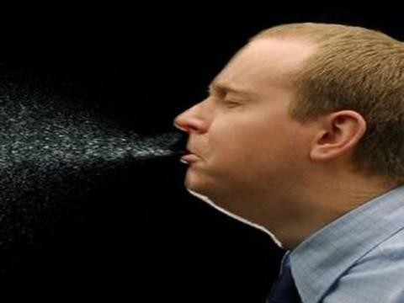
How is Novel Coronavirus transmitted?
All the clusters of cases seen so far have been transmitted between family members or in a health care setting, the WHO said in an update .
Human-to-human transmission occurred in at least some of these cluster.
. Air/droplet
Physical contact
Exchange of body fluids
Contact with contaminated surface

Slide 17
Symptoms
A person will show the symptoms after a week
Flu-like symptoms,
a heavy cough. common cold
headache
fever
sore throat
shortness of breath.

Slide 18
LATER COMPLICATIONS
PNEUMONIA
ARDS
SEPTIC SHOCK
MULTIORGAN FAILURE
DEATH

Slide 19
Lab Diagnosis
Real-Time PCR
ELISA test

Slide 20
Can 2019-nCoV be caught from a person who presents no symptoms
Understanding the time when infected patients may spread the virus to others is critical for control efforts. Detailed medical information from people infected is needed to determine the infectious period of 2019-nCoV. According to recent reports, it may be possible that people infected with 2019-nCoV may be infectious before showing significant symptoms. However, based on currently available data, the people who have symptoms are causing the majority of virus spread

Slide 21
How long is the incubation period?
The incubation period is the time between infection and the onset of clinical symptoms of disease. Current estimates of the incubation period range from 2-12.5 days with median estimates of 5-6 days. These estimates will be refined as more data become available. Based on information from other coronavirus diseases, such as MERS and SARS, the incubation period of 2019-nCoV could be up to 14 days. WHO recommends that the follow-up of contacts of confirmed cases is 14 days

Slide 22
How dangerous is it?
As with other respiratory illnesses, infection with 2019-nCoV can cause mild symptoms including a runny nose, sore throat, cough, and fever. It can be more severe for some persons and can lead to pneumonia or breathing difficulties. More rarely, the disease can be fatal. Older people, and people with pre-existing medical conditions (such as, diabetes and heart disease) appear to be more vulnerable to becoming severely ill with the virus

Slide 23
Can the 2019-nCoV be transmitted from person to person?
Yes, the 2019-nCoV causes respiratory disease and can be transmitted from person to person, usually after close contact with an infected patient, for example, in a household workplace, or health care center

Slide 24
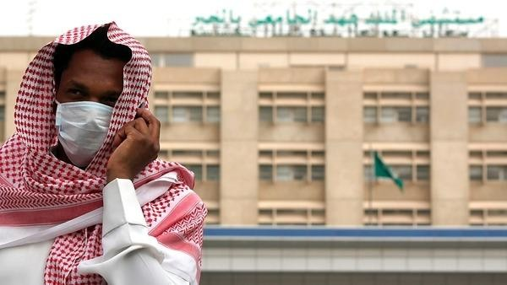
Prevention Measures

Slide 25

Prevention Measures

Slide 26
What can I do to protect myself?
Wash your hands frequently
Wash your hands frequently with soap and water or use an alcohol-based hand rub if your hands are not visibly dirty.
Why? Washing your hands with soap and water or using alcohol-based hand rub eliminates the virus if it is on your hands.
Practice respiratory hygiene
When coughing and sneezing, cover mouth and nose with flexed elbow or tissue – discard tissue immediately into a closed bin and clean your hands with alcohol-based hand rub or soap and water.
Why? Covering your mouth and nose when coughing and sneezing prevent the spread of germs and viruses. If you sneeze or cough into your hands, you may contaminate objects or people that you touch

Slide 27
CONTI…
Maintain social distancing
Maintain at least 1 metre (3 feet) distance between yourself and other people, particularly those who are coughing, sneezing and have a fever.
Why? When someone who is infected with a respiratory disease, like 2019-nCoV, coughs or sneezes they project small droplets containing the virus. If you are too close, you can breathe in the virus.
Avoid touching eyes, nose and mouth
Why? Hands touch many surfaces which can be contaminated with the virus. If you touch your eyes, nose or mouth with your contaminated hands, you can transfer the virus from the surface to yourself.
If you have fever, cough and difficulty breathing, seek medical care early
Tell your health care provider if you have traveled in an area in China where 2019-nCoV has been reported, or if you have been in close contact with someone with who has traveled from China and has respiratory symptoms.

Slide 28
CONTI…
Why? Whenever you have fever, cough and difficulty breathing it’s important to seek medical attention promptly as this may be due to a respiratory infection or other serious condition. Respiratory symptoms with fever can have a range of causes, and depending on your personal travel history and circumstances, 2019-nCoV could be one of them.
If you have mild respiratory symptoms and no travel history to or within China
If you have mild respiratory symptoms and no travel history to or within China, carefully practice basic respiratory and hand hygiene and stay home until you are recovered, if possible.

Slide 29
CONTI….
As a general precaution, practice general hygiene measures when visiting live animal markets, wet markets or animal product markets
Ensure regular hand washing with soap and potable water after touching animals and animal products; avoid touching eyes, nose or mouth with hands; and avoid contact with sick animals or spoiled animal products. Strictly avoid any contact with other animals in the market (e.g., stray cats and dogs, rodents, birds, bats). Avoid contact with potentially contaminated animal waste or fluids on the soil or structures of shops and market facilities.
Avoid consumption of raw or undercooked animal products
Handle raw meat, milk or animal organs with care, to avoid cross-contamination with uncooked foods, as per good food safety practices.

Slide 30
….
How to put on, use, take of and dispose of a mask
Before putting on a mask, wash hands with alcohol-based hand rub or soap and water
Cover mouth and nose with mask and make sure there are no gaps between your face and the mask
Avoid touching the mask while using it; if you do, clean your hands with alcohol-based hand rub or soap and water
Replace the mask with a new one as soon as it is damp and do not re-use single-use masks
To remove the mask: remove it from behind (do not touch the front of mask); discard immediately in a closed bin; wash hands with alcohol-based hand rub or soap and water

Slide 31
Who is at risk of developing severe illness?
While we still need to learn more about how 2019-nCoV affects people, thus far, older people, and people with pre-existing medical conditions (such as diabetes and heart disease) appear to be more at risk of developing severe disease

Slide 32

ANTIMICROBIAL DRUGS

Slide 33
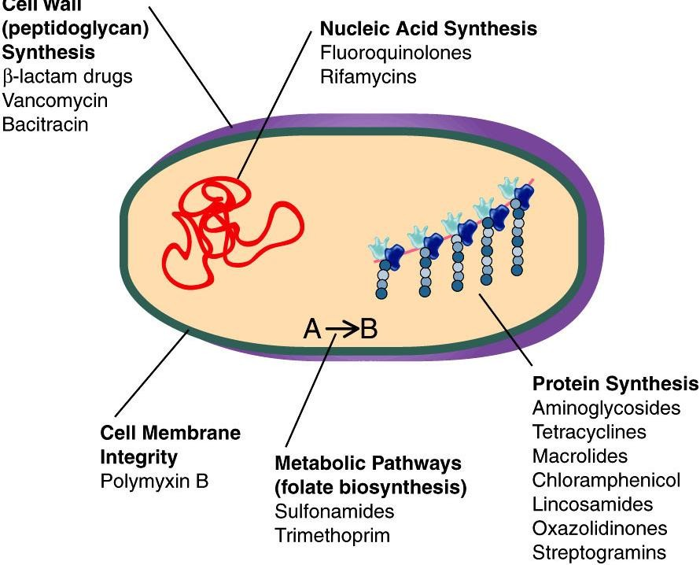
MECHANISMS OF ACTION OF ANTIBACTERIAL DRUGS
Mechanism of action include:
  Inhibition of cell wall
synthesis
  Inhibition of protein synthesis
  Inhibition of nucleic acid synthesis
  Inhibition of metabolic pathways
  Interference with cell membrane integrity

Slide 34
CONTI…
Vaxart coronavirus vaccine
Vaxart is developing an oral recombinant vaccine in tablet formulation using its proprietary oral vaccine platform.
BXT-25 by BIOXYTRAN to treat late-stage acute respiratory distress syndrome (ARDS)
Remdesivir (GS-5734) by Gilead Sciences
lopinavir is being studied along with ritonavir (HIV )
Biocryst Pharma’s Galidesivir, a potential antiviral for coronavirus treatment

Slide 35
Coronavirus in India
Total positive cases:03
THIRUVANANTHAPURAM: The third novel coronavirus case has been reported in India, with another Keralite student who returned from Wuhan university on Monday testing positive for the infection.
Two earlier positive cases, also of students who came back from Wuhan, the epicentre of the epidemic, were reported from Thrissur & Alapuzha districts.
The condition of the student is "stable"
3252 people under observation in Kerala for Coronavirus
India evacuated around 647 Indians from Wuhan and screened

Slide 36
CURRENT DATA
17 Feb.2020
Coronavirus Cases: 73,336
Deaths: 1,874
Recovered: 12,921
19Feb.2020
Coronavirus Cases: 75,216(M) 75223(A)
Deaths: 2,012
Recovered: 14,719

Slide 37
Country, Other | Total Cases | New Cases | Total Deaths | New Deaths | Total Recovered | Serious, Critical
China | 72,438 | +1,890 | 1,869 | +99 | 12,757 | 11,741
Diamond Princess | 454 |  |  |  | 17 | 19

Slide 38
Japan | 66 |  | 1 |  | 18 | 19
Hong Kong | 61 | +1 | 1 |  | 2 | 7
Singapore | 77 |  |  |  | 24 | 4
Thailand | 35 |  |  |  | 15 | 2
Italy | 3 |  |  |  |  | 2
U.A.E. | 9 |  |  |  | 3 | 1
S. Korea | 31 | +1 |  |  | 12
Taiwan | 22 |  | 1 |  | 2
Malaysia | 22 |  |  |  | 9

Slide 39
Vietnam | 16 |  |  |  | 7
Germany | 16 |  |  |  | 9
USA | 15 |  |  |  | 3
Australia | 15 |  |  |  | 10
France | 12 |  | 1 |  | 5
Macao | 10 |  |  |  | 5
U.K. | 9 |  |  |  | 8
Canada | 8 |  |  |  | 1
Philippines | 3 |  | 1 |  | 2
India | 3 |  |  |  | 3
Russia | 2 |  |  |  | 2

Slide 40
Spain | 2 |  |  |  | 2
Nepal | 1 |  |  |  | 1
Belgium | 1 |  |  |  | 1
Sri Lanka | 1 |  |  |  | 1
Finland | 1 |  |  |  | 1
Egypt | 1
Cambodia | 1 |  |  |  | 1
Sweden | 1

Slide 41




