Slide 1
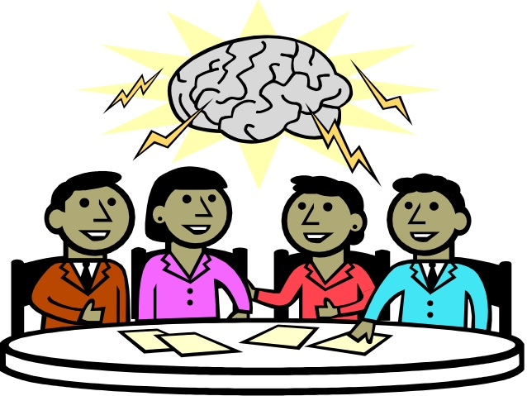
PSYCHOTHERAPY
Dr Anupama.k
Akal College of Nursing

Slide 2
You’re not alone.”
comm
Common meaning are sympathy or agreement

Slide 3
HISTORY

Slide 5
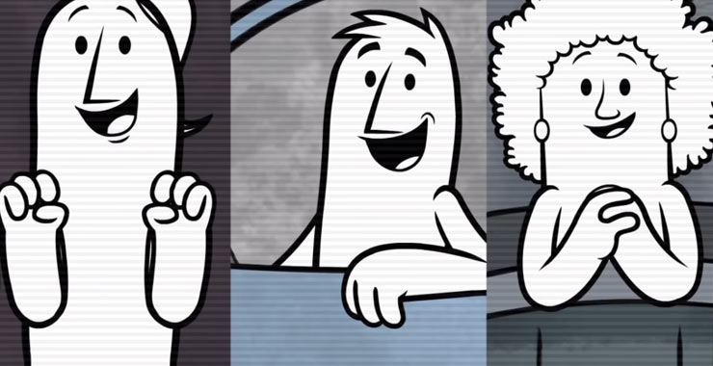
How it works……..…………………?

Slide 6
what exactly is psychotherapy
Most people have heard the term “psychotherapy”, but don’t have an accurate concept of what it really is.
So what exactly is psychotherapy?
Psychotherapy aims to enable patients, or clients, to recognize both positive and negative feelings, and what triggers or situations can make them feel good, nervous, or depressed.
This allows them to cope with difficulties in a more constructive way.

Slide 7
Most courses of therapy last less than a year, and clients who are excited to change and willing to work often report great outcomes.
Psychotherapy helps with a diverse set of problems, including depression and Low self-esteem, Addiction and Family quarrels.
Anyone overwhelmed by daily problems and an inability to cope can benefit from psychotherapy.

Slide 8
Psychotherapy is both an art and a science. Understanding the contribution of both these elements and achieving a proper balance in actual episodes of therapy is essential to optimize therapeutic success.

Slide 10
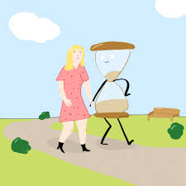
HOW LONG ………????
Most psychotherapy today is short-term and lasts less than a year.
Most common mental disorders can often be successfully treated in this time frame, often with a combination of psychotherapy and medications.

Slide 11
WHEN THIS THERAPY IS successful???
Psychotherapy is most successful when the individual enters therapy on their own and has a strong desire to change.
If you don’t want to change, change will be slow in coming.

Slide 12
It is most successful when a person is able and willing to try to do this in a safe and supportive environment

Slide 13
There are many different approaches to psychotherapy.
Use of one method or another depends on the psychologist’s
Some psychologists use one approach with all patients; others are eclectic, and some tailor their approach based on particular patients’ needs, symptoms and personality.
The Psychodynamic approach focuses on understanding where the patient’s problems or symptoms came from.

Slide 14
WHAT IS …..Fundamental Purpose of Psychotherapy???
Fundamental purpose of psychotherapy remains to strengthen the Mind, the psyche and the soul.
In the valuing of our words, Talk Therapy teaches us the value of taking ourselves seriously — finally placing value where it belongs.

Slide 17
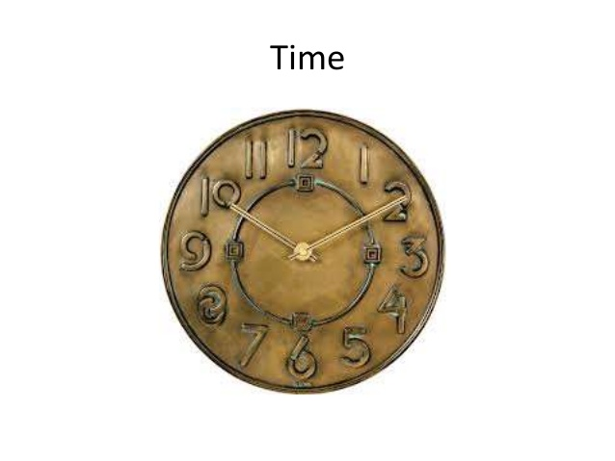

Slide 19
Psychotherapy is usually time-limited and focuses on specific goals you want to accomplish.

Slide 25
Ventilation
Ventilation means allowing the client to speak about his problems without restriction or inhibition.
Ventilation is an important Technique in Therapy, particularly during the early phases.
This is supportive Technique where in the client is encouraged to Talk about his problems. By Talking, the client's Emotional distress decreases, and both he and the counselor obtain a clearer picture of the problem situation.

Slide 26
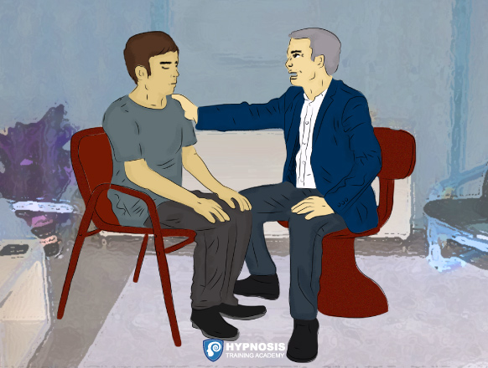

Slide 30
Persuasion is a process aimed at changing a person's (or a group's) attitude or behavior Toward some
Event,
Idea,
object, or other person(s),
by using written, Spoken words or visual tools to convey information,
feelings, or reasoning, or a combination

