Slide 1

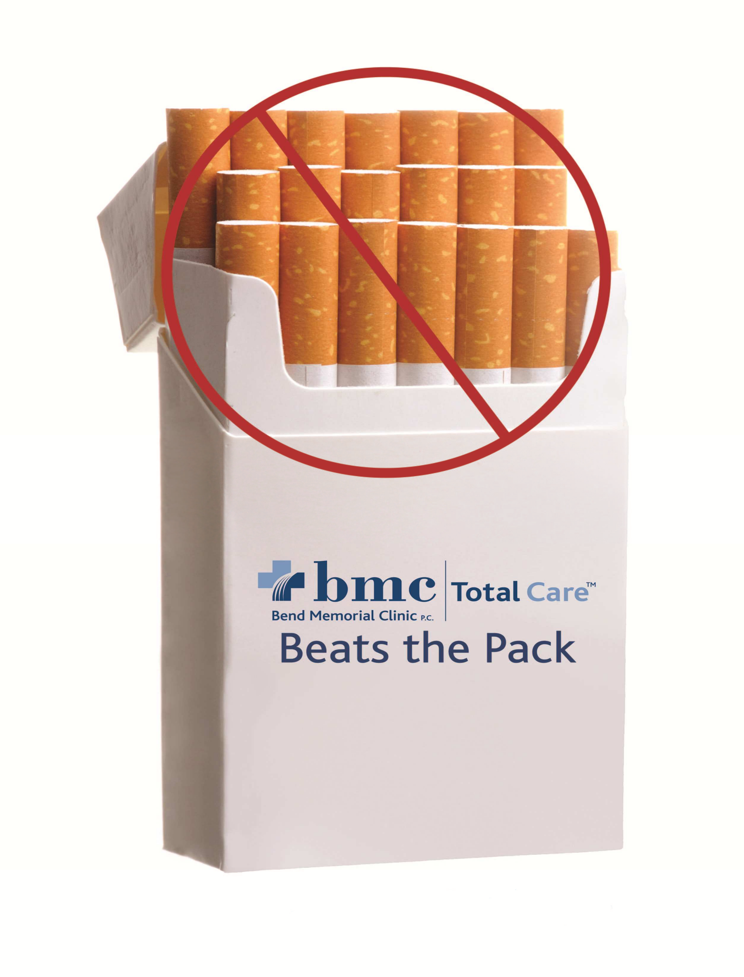

Slide 2

Entire Body Impact
Cancer
Voice box Throat Breast Lung Blood Stomach Pancreas Kidney
Chronic Disease
Stroke
Blindness, cataracts Aneurysm
Heart disease; Asthma Pneumonia
Blocked blood flow to legs and arms
Lung airway blockage Hip fracture Reproductive disorders
World Health Organization, 2008

Slide 3

Second Hand Smoke
Children
Brain Ear disease Cancer of lymph Respiratory
SIDS
Leukemia Airway & Lung
Adults
Stroke
Irritation of the nose Heart disease/ Asthma Breast cancer
Lung cancer Hardening of arteries Lung airway blockage Breathing problems Premature birth
World Health Organization, 2008

Slide 4

Impact on Immune System
Nicotine impacts muscles, joints, tendons/ligaments, mental acuity and the immune system.
Not only is the immune system by far the most powerful and effective healing force, it is so sophisticated that it builds a partial immunity to the continuous introduction of poison to the body.
When someone teaches themselves to smoke tobacco, they build an immunity or tolerance to the bad taste and poisonous effects of the drug itself.

Slide 5
Impact on the Brain
Nerve cells in the brain and peripheral nervous system have special protein receptors on their surfaces to which nicotine binds.
When a molecule of nicotine binds to a nicotine receptor, the receptor causes the neuron to transmit a nerve impulse to various target organs and tissues.
This process stimulates the release of neurotransmitters (chemical messengers) which produce the physiological and psychological effects of nicotine.

Slide 6
Impact on the Brain
Each neurotransmitter has its own specific family of receptors. Nicotine works by docking to a subset of receptors that bind the neurotransmitter, acetylcholine.
Depending on what region of the brain a neuron is in, these altered chemicals - acetylcholine and norepinephrine – deliver signals from brain to muscles; control basic functions like energy level, heartbeats and how you breath; acts as “traffic cop” overseeing the flow of information to the brain and plays a role in learning and memory.

Slide 7
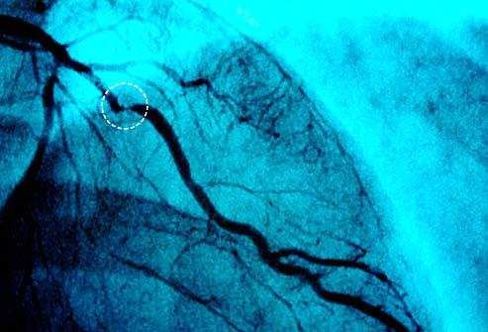
Impact on the Body
Nicotine profoundly affects hormones/ neurotransmitters
This affects the nervous system and the cardiovascular network.
The result is diminished and eventually destroyed breathing ability and elevation of already dangerous levels of carbon monoxide.
It also increases bad
cholesterol levels, etc.

Slide 8
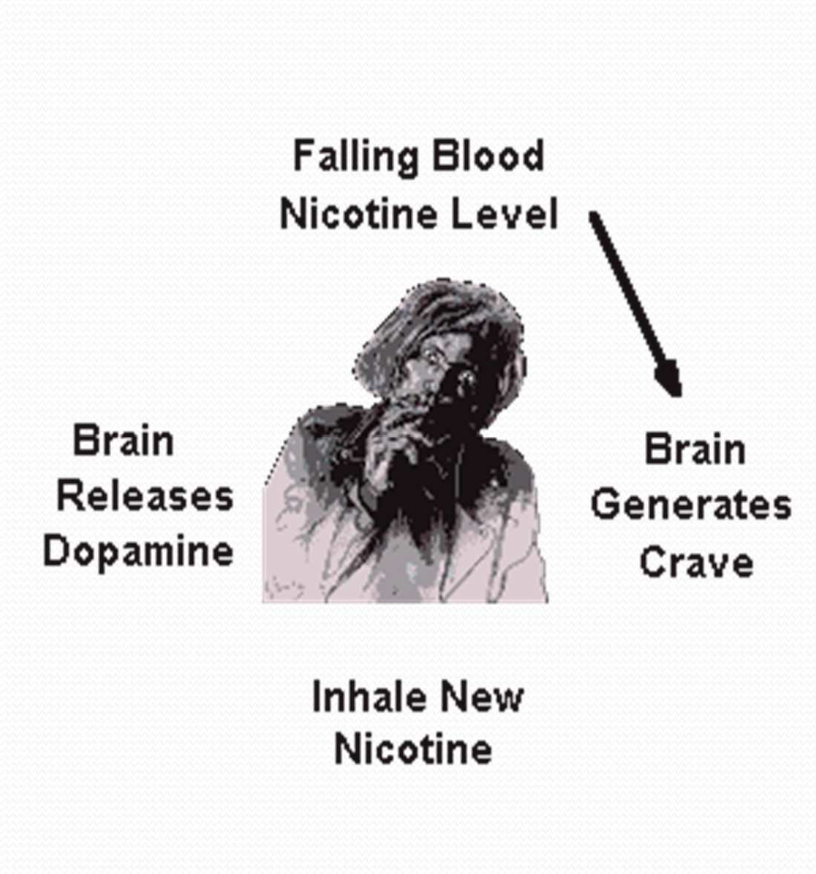
Impact on the Brain and Body
The quick burst of energy (or “buzz”) from smoking a cigarette is closely followed by tiredness.
The energy lasts only seconds and then the energy expended and the chemicals ingested drag your energy level right down.

Slide 9
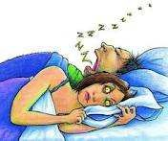
Impact on Sleep
Cigarette smokers are four times as a likely to feel unrested after a night’s sleep.
Smoking results in less deep sleep, more easily disturbed light sleep.
Nicotine withdrawal each night contributes to sleep disturbances.
Sleep deprivation increases depression, anxiety and other psychiatric disorders.

Slide 10
Nicotine and Insulin
Nicotine also inhibits the release of insulin from the pancreas, a hormone that is responsible for removing excess sugar from a person's blood.
This leaves the smoker in a slightly hyperglycemic condition, meaning he has more sugar in his blood than is normal. High blood sugar acts as an appetite suppressant, which may be why smokers think their cigarettes reduce hunger.

Slide 11
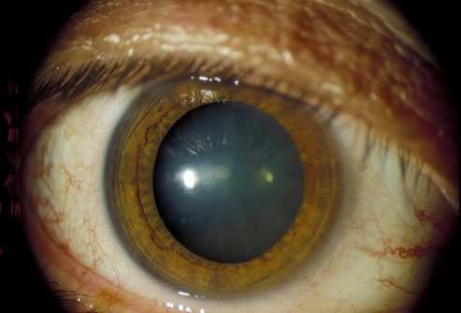
Smoking and Eyesight
Cataracts
Increases the risk of cataracts as you age.
These are cloudy areas on the lens of the eye that keep light from reaching the retina.
Serious vision problems are treated with surgery.

Slide 12

The Risk of Heart Attacks
Smoking increases blood pressure and makes it easier for blood to clot.
For people who have recently had heart attacks or have unstable irregular heartbeats, nicotine can speed up the heart rate and promote an
irregular rhythm.
The arteries that carry blood to the heart become narrowed over time.

Slide 13
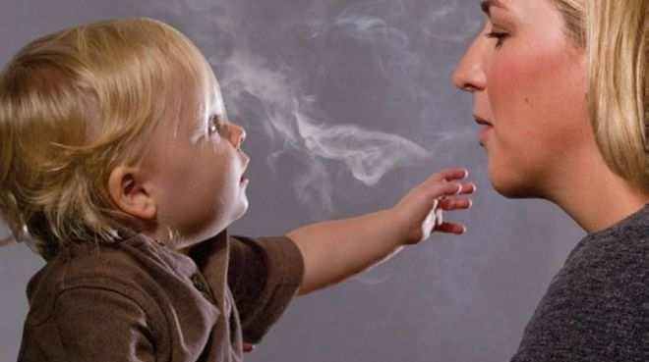
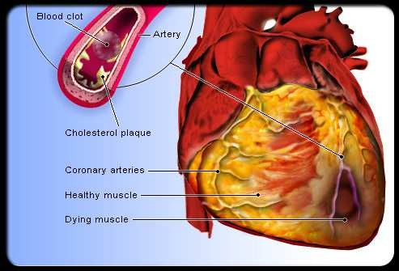
Second-Hand Smoke
• Secondhand smoke
can and does cause cardiovascular disease and heart attack.
• Every year in the U.S., approximately 46,000 non-smokers who live with smokers die from heart disease.

Slide 14
Second-Hand Smoke and Cardiovascular Disease
Secondhand smoke can and does cause cardiovascular disease and heart attack.
Every year in the U.S., approximately 46,000 non-smokers who live with smokers die from heart disease.

Slide 15
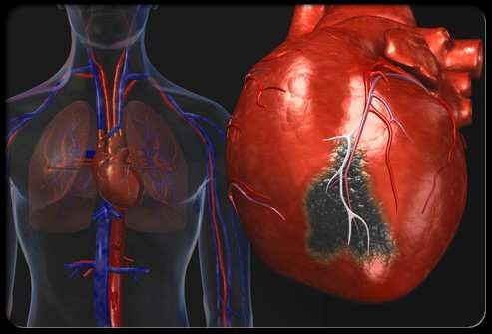
Second-Hand Smoke and Cardiovascular Disease
Brief exposure to secondhand smoke can have immediate harmful effects.
People with existing heart disease are at especially high risk and should avoid any exposure.

Slide 16
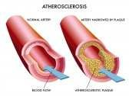
Atherosclerosis, Strokes, Aortic Rupture
Early smoking by teens damages the blood vessels that can later lead to heart attack, stroke and aortic rupture.
White males ages 25 to 34 are twice as likely to have advanced damage (“atherosclerosis”) of the abdominal aorta as non-smokers.

Slide 17
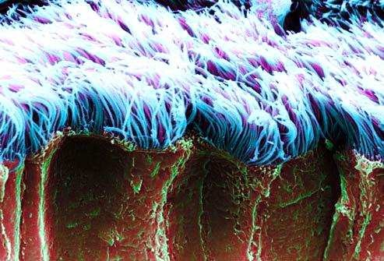
Smoking and the Lungs
Tar: The oily, sticky, brown stuff that leaches out of cigarettes.
Tar coats the inside of the lungs.
The cilia are burned off by the hot smoke and paralyzed by nicotine.
There is almost no resistance to the buildup of tar.

Slide 18
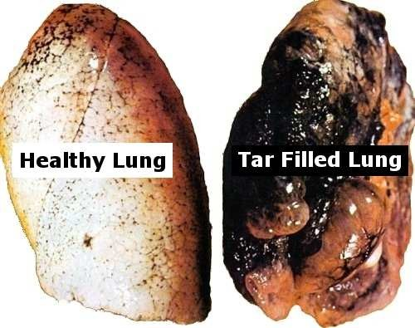
Tar Build-up in the Lungs
The amount of tar accumulated in one year in the lungs can exceed a full quart.
As the tar gets thicker and thicker, it traps more and more of the 1000’s of poisonous chemicals in cigarette smoke.

Slide 19
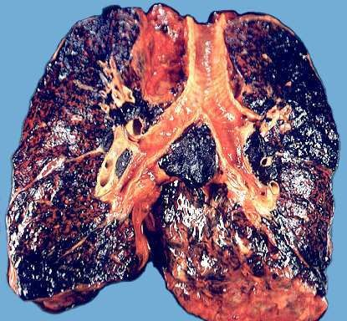
Smoking and The Lungs
The tar also causes the body to produce higher amounts of mucus in a constant attempt to clean the lungs.
The mucus covers
Smokers are consistently
the remaining stubs of the embattled cilia.
bringing in new tar, while their body struggles to remove the old tar.

Slide 20
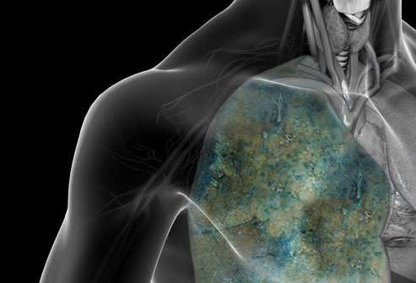
Lung Cancer
Lung cancer is the top cancer killer of men and women in the U.S.
Nine out of ten people who die from cancer will die from lung cancer.

Slide 21
Smoking and The Lungs
Even low exposure to tobacco causes permanent damage to lung tissue.
ANY level of cigarette smoking or exposure to smoke makes the cells in the lungs sick.
The growth of lung and lung capacity stops a year earlier in teens who smoke.
Lung function declines 15 years earlier in smokers.

Slide 22
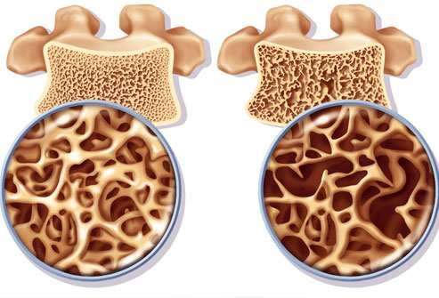
Brittle Bones
Smoking raises your risk of:
Weak bones (osteoporosis)
Bone fractures
Curvature of the spine (leaving you hunched over)

Slide 23
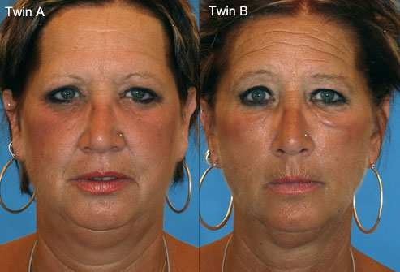
Which Twin Is The Smoker?

Slide 24
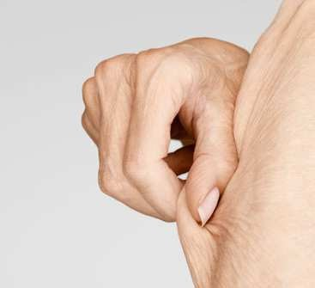
Smoking and the Skin
Smoking
  Changes the color of skin to a sallow-gray.
  Can cause wrinkles on the faces of smokers as young as 20 years old!
  Destroys collagen and elasticity.
  Post operative scars of smokers are three times as wide as those of non- smokers.

Slide 25
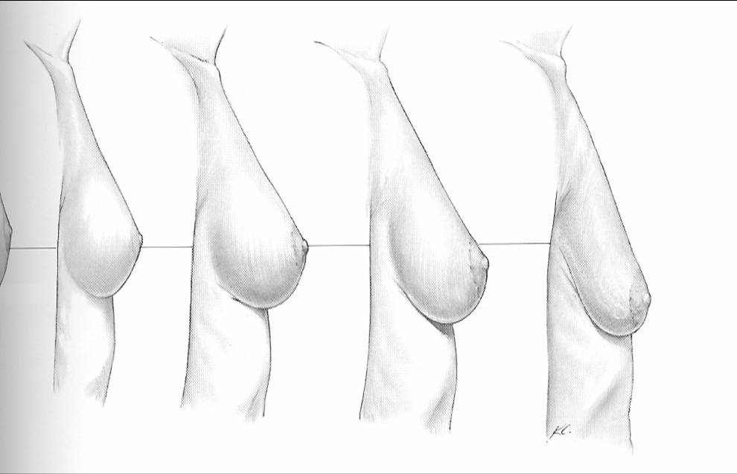
Smoking Can Cause Sagging Breasts

Slide 26
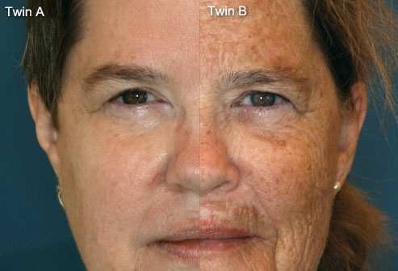
Skin Damage: Age Spots

Slide 27
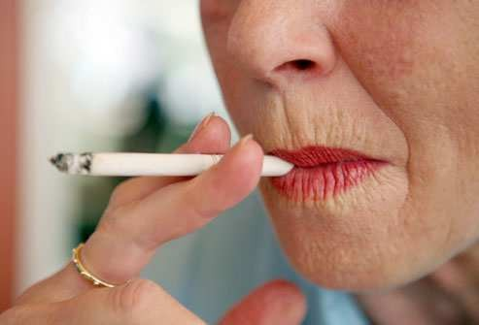
Skin Damage: Smoker’s Pucker

Slide 28
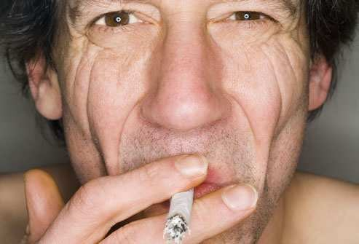
Crow’s Feet Eye Wrinkles

Slide 29
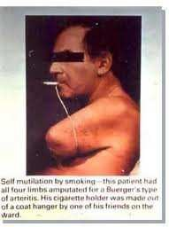
Buerger’s Disease
Self mutilation by smoking.
The patient lost all four of his limbs to this smoking-related disease but still manages to feed his nicotine addiction.
His cigarette holder was made out of a coat hanger by one of his friends on the ward.

Slide 30
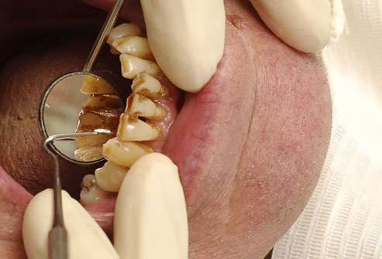
Smoking and Oral Health
Yellow teeth
Gum disease
Persistent bad breath
Tooth loss (twice as likely as non- smokers)

Slide 31
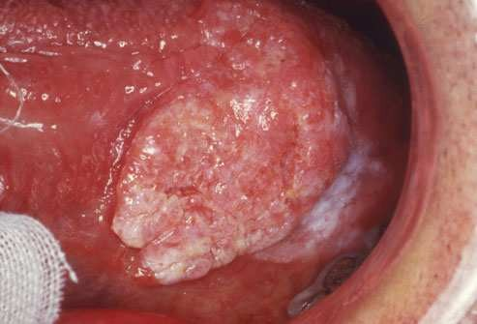
Oral Cancer
People who smoke or chew tobacco are much more likely to develop oral cancer.
Smoking and drinking can increase the risk of oral cancer 15 times.
Quitting smoking lowers the risk for oral cancer substantially within a few years.

Slide 32
Smoking and Weight
Smoking speeds up the metabolism, thus increasing the amount of energy – calories - being used up.
When the smoker quits, their metabolism returns to its pre-smoking rate.
Smoking can cause a loss of lean muscle mass (the true key to a faster metabolism) primarily because of the accelerated increase in metabolism from smoking.
Smokers are actually more likely to put on weight over time due to the damage caused by smoking to their lean muscle mass.

Slide 33
Smoking and Weight
Thinness from smoking weakens the body from poor health. At the same time, using cigarettes for stress management weakens the mind’s psychological response to life’s coping through rote responses.
Some scientists think that the cravings for sweets may be because nicotine addiction affects the level of blood sugar in the body so that nicotine withdrawal triggers an increased craving for sweet foods.
The extra hunger people feel after quitting is not a genuine need for nutrition, but an addictive hunger so they end up replacing one addiction with another.

Slide 34
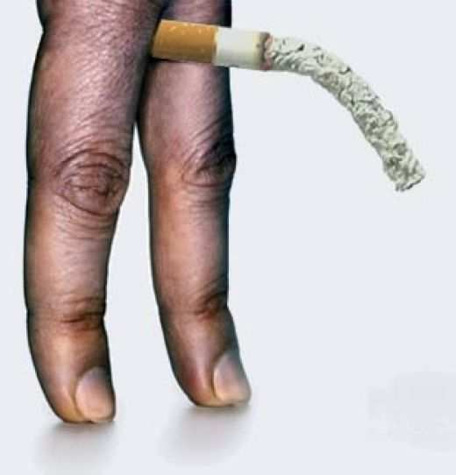
Smoking and Sex
ED typically presents itself in long-term smokers once they hit their late 40’s and 50’s.
Smoking can cause lower sperm count and reduced sperm motility.
Women can experience less sensitivity during intercourse and find it harder to achieve orgasms.
The smell of smoking on the breath, hair and clothes reduces attraction and can
lead to dating break-ups, marital separation and divorce.
Erectile Dysfunction (ED)

Slide 35
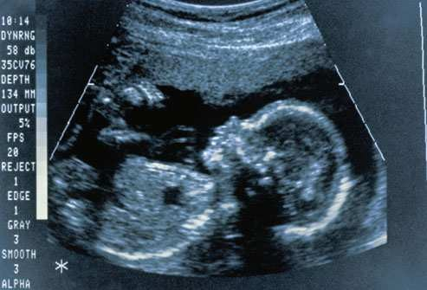
Smoking and Reproduction
Fertility problems
Premature menopause
Problems giving birth
Smoking during pregnancy:
  Low birth weights
  Clef palates
  Pre-term births
  Low blood flow/oxygen to the fetus
  Cerebral Palsy
  Lower IQ
  Attention Deficit Disorder

Slide 36
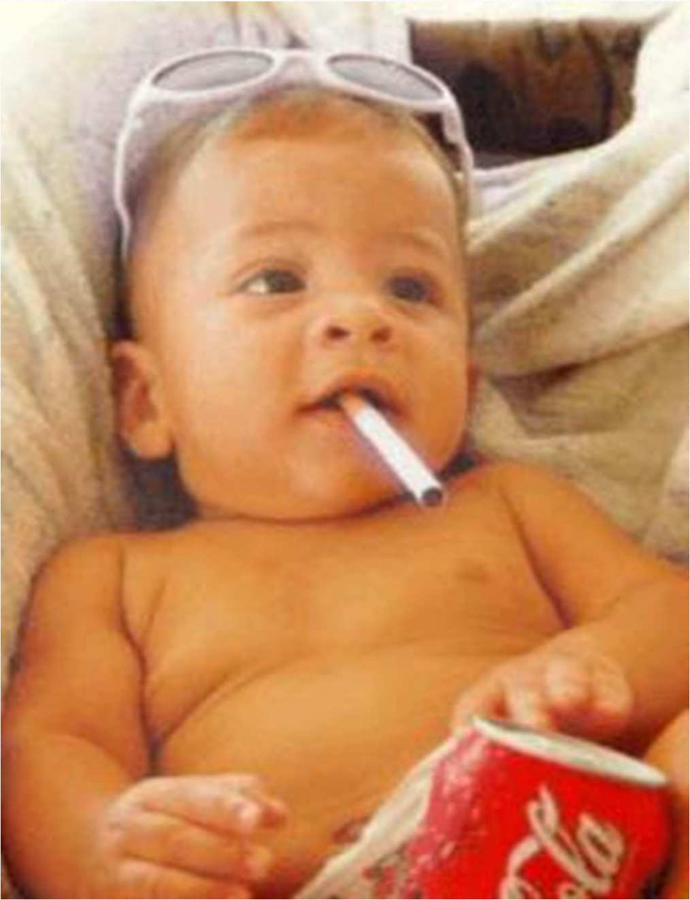
SecondHand Smoke and Children
Children have increased risk of:
  asthma flare-ups
  cold and ear infections
  sudden infant death syndrome
  Developmental problems may not show up until later in their childhood

Slide 37

Smoking In Utero
During pregnancy a smoking mother is:
  more likely to bleed (sometimes severely)
  more likely to have abnormal placement/location of the placenta
Infants suffer nicotine withdrawal when their mothers smoke in utero.

Slide 38
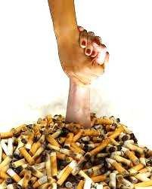
A Final Message
Patients who express a readiness to quit smoking or chewing should be referred to BMC’s Tobacco Cessation Program.
CONTACT:
Anne Palmer via Allscripts, Email or Ext. # 4506

