Slide 1
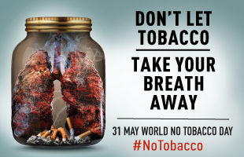
WORLD NO TOBACCO DAY
31st MAY, 2020

Slide 2
Tobacco Consumption Pattern & Hazards

Slide 3
Tobacco Consumption Patterns
20 per cent tobacco-users consume Cigarettes.
40 per cent smoke Beedis.
Remaining 40 per cent chew tobacco and tobacco – containing products such as Paan Masala, Gutkha and Khaini.

Slide 4
Different forms of Tobacco

Slide 11
Cont…
People can smoke, chew, or sniff tobacco. Smoked tobacco products include Cigarettes, Cigars, Beedis, and Kreteks. Some people also smoke loose tobacco in a pipe or hookah (water pipe). Chewed tobacco products include chewing tobacco, snuff, dip; snuff can also be sniffed.

Slide 12
Forms of Tobacco used in India
Tobacco use is ingrained as a cultural practice and resultant addiction in India.
In India, tobacco is used as smoked and smokeless forms. There are myriad forms.
Cigarettes are available in various types, filtered/unfiltered, length based, and flavored.

Slide 13
Forms of Tobacco used in India
Beedi is an indigenous form of tobacco product, made with 0.2 to 0.3 g of tobacco wrapped in temburni leaf and tied with a small string. Beedis contain 3 times more nicotine and 5 times more amount of tar than the regular cigarette, and they are also available in flavors of strawberry, mango, and chocolate.
Smokeless tobacco is a form of tobacco that need not be ignited for use, applied orally and nasally.

Slide 14
Patterns and Prevalence of Tobacco Use in India
India is the second largest consumer of tobacco. Global Adult Tobacco Survey-2 reports that 28.6% of the population consume tobacco in any form, 10.7% smoke, and 21.4% use SLT.
Khaini (a form of SLT) and beedis are the dominant forms of tobacco consumed in India, at 11% and 8%, respectively. Compared with GATS 2010, there has been a 6% decrease in the tobacco consumption recorded in GATS 2017 and also the NFHS-4 has shown decrease in the prevalence rate compared with NFHS-3.

Slide 15
Cont…
Smoked form was consumed by 14% of the population. On an average, Indians smoked about 6.2 cigarettes per day; this is the lowest of all countries, but among women, although the prevalence of cigarette smoking was less, the mean cigarettes per day were quite high, about 7, higher than the average of men, which was 6.1.

Slide 16
Cont…
Beedis accounted for the largest proportion of smoked tobacco consumed in India, especially among the lower socio-economic group, they consume beedis 8 to 10 times more than cigarette smoking. Despite greater consumption and higher toxicology associated with beedis, they go unnoticed.
A study that assessed trends in beedi and cigarette smoking in India from 1998 to 2015 showed that cigarettes were displacing beedis among men due to rising income and increased affordability; this was also significantly noticed among the lower socio-economic status groups.

Slide 17
Cont…
India has the largest number of SLT users in the world. Of the 346 million global consumers, India alone has 152.4 million men and 80.8 million female SLT consumers, and there has been substantial increase in SLT across all age groups. A study analyzed 2 nationally representative data in 2005 and 2009 and showed that SLT use continued to increase in the age group of 15 to 49 years.
The prevalence of SLT use is higher among men (27%-37%) compared with women (10%-15%). Moreover, SLT use is considered as a common smoking cessation method and a study showed that 34.4% of smokers switched to SLT use as a cessation method.

Slide 18
Secondhand smoke
Secondhand smoke (SHS) exposure is a significant problem in India, at both indoor and outdoor. A study has shown that 70% to 80% of the male smokers regularly smoked in home; 3 in every 10 adults working indoor are exposed to SHS. About 23% of adults have reported SHS exposure at public places. In NFHS-3, 25% women reported SHS exposure at home.

Slide 19
Third hand smoke
Is the fraction of tobacco smoke that persists in indoor environments after smoking. This remains even after most of the airborne components of the smoke have cleared.
Children are at increased risk, when exposed to thirdhand smoke (THS) toxicants due to their exploratory behavior and metabolic activity.
Dust ingestion was identified as the dominant (80% of the total intake) source of exposure to indoor semi-volatile environmental pollutants in toddlers. This is of enormous importance in India as houses especially in urban slums are compact with poor ventilation. Nicotine is the main component in THS.

Slide 20
Cont…
Oxidants in the tobacco smoke cause local and systemic inflammation. Thirdhand smoke causes significant DNA damage in human cells.
Small children are particularly vulnerable as they are exposed to THS/toxicants via inhalation, ingestion, and dermal contact. And also, there is increased risk of cancer in children (1-16 years).

Slide 21
Hazards of Tobacco Use

Slide 22
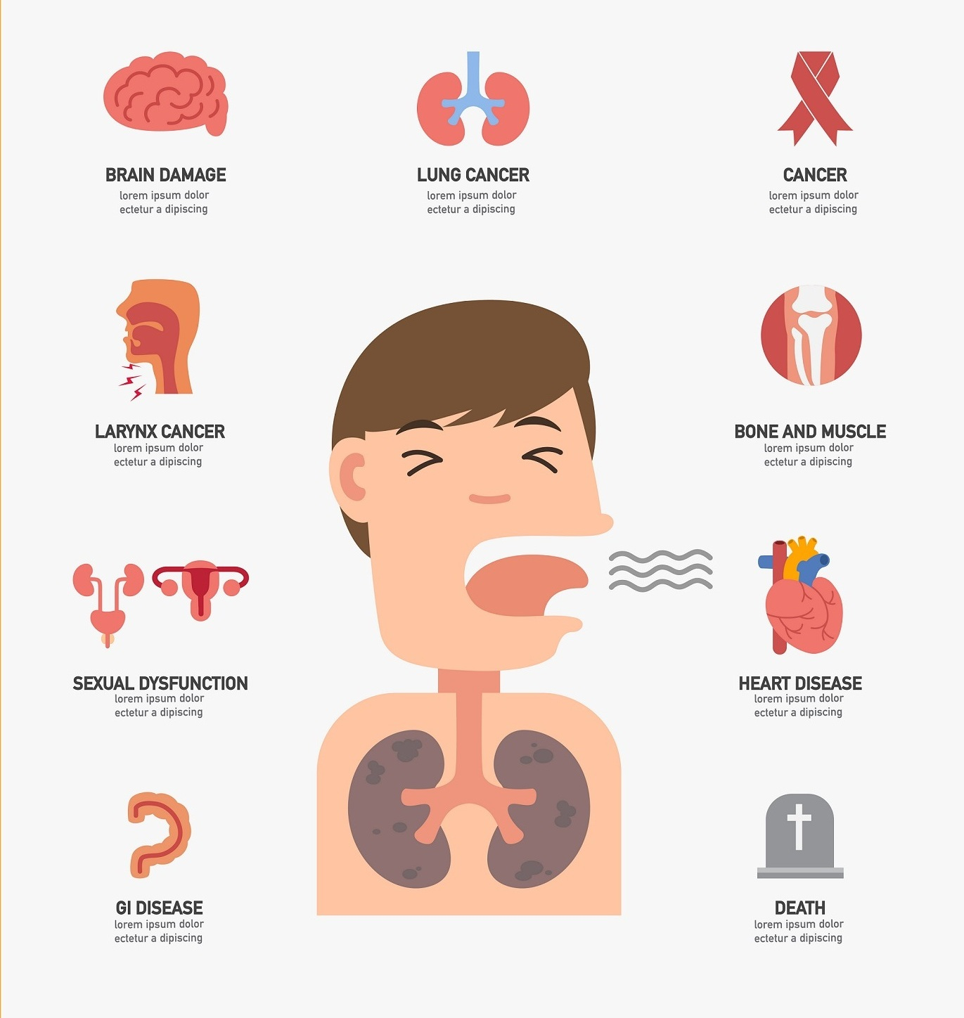

Slide 24
Psychological Hazards of Tobacco
Stress
Anxiety
Depression
Increased irritation

Slide 25
Latest News
Union Ministry of Health and Family Welfare has on Monday issued a notification specifying new health warnings on tobacco products packs. The Ministry of Health has ordered printing of new photographs containing warnings on all tobacco products.
All tobacco products that have been packaged on or after Sep 1, 2020, will have to display the 1st image and the products which are packaged on or after Sep 1, 2021 will have to display the second image.

Slide 28
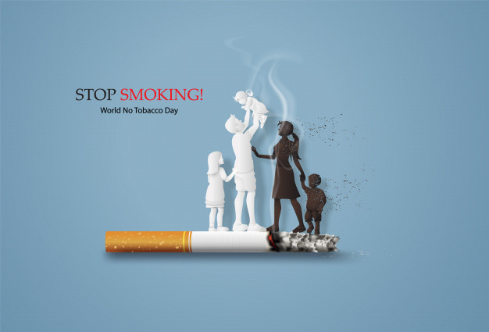

Slide 29
References:
https://journals.sagepub.com/doi/full/10.1177/1179916118759289
https://nhm.gov.in/index1.php?lang=1&level=3&sublinkid=1125&lid=638

