Slide 1
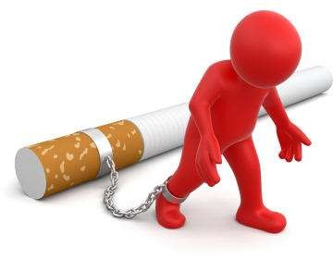



Slide 2
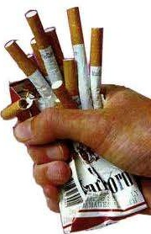
You must first take time figuring out the kind of a smoker your are. Figure out the moments of life you normally smoke and why you smoke.
Identify the
things, situations, feelings and people who influence you to smoke. This will enable you to identify which steps or techniques to follow.

Slide 3

Make a plan and set a quit date like two weeks before, so that you can prepare without loosing your motivation to quit. If possible quit your work especially if you normally smoke during work to have some time to prepare.
Inform your colleagues and family members that your are quitting , let them help you and support you. If you get someone who also is quitting you can motivate each other through these rough times.

Slide 4

Be ready to face the common challenges while quitting. Some challenges will force you to start smoking again but you should work hard to help yourself in making it through by preparing ahead for these challenges like cigarette cravings.

Slide 5
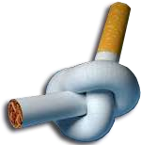
Throw away all tobacco leftovers, lighters cigarettes from your home, car, and work. Wash and clear anything that smells like cigarette from your home.
Select the suitable methods of quitting.
  Seek for a counseling help from a doctor. You can meet him or do it On phone. quit smoking Brisbane is one place where you can get
Assistance.
  Join a support group. If you find people trying to quit, they can Help you to quit smoking for good.
  Do not forget seeking for help from your family members and Friends. Do not give up, try again and again until you quit for good. The more you practice the more it becomes easier, boosting your
Chances of quitting permanently. Never see yourself as a failure If you slip, but keep trying.
  Keep in mind that this process is hard. Therefore You must employ the whole of your energy, time
And even money in this process.

Slide 6

Exercise is a very important tool When you're quitting smoking. It is healthy alternative to smoking as it can take your mind off your cravings and help your mood. It is important to start slowly when you are new in doing exercise.
You can also do other activities that can ward your mind
From smoking. You can take
Time and take a walk to the Beach, go to the movies, local town, play a sport or play with Your pets.
Always keep in mind that being
busy can help you a great
Deal in getting away from smoking.

Slide 7

Avoid being idle, as it is said; “an idle mind is the devil’s work place”. Find some thing to do always to avoid boredom. You can work in your garden, clean your house, wash your car, cook your favorite food or read a book.
It is vital to avoid smoking areas, keeping in mind that you are not promoting yourself alone, but the people
around you, loved ones and the family members as well.
But the most essential Thing is that, your choice Is the best, it is very Important to your health And the reduced risk
Of acquiring diseases.

Slide 8

Be confident that you can be successful in quitting smoking. By following the required procedures, you can deal with this habit and quit smoking for good. Keep in mind that nicotine withdrawal symptoms lasts a very short time. You should therefore take one day at a time.
Set goals and always remember that you will soon feel better
after this procedure.
You can reward yourself after every milestone
Avoid the situations where you will be tempted to smoke. If you normally smoke in a specific chair, avoid sitting in that same chair again. If you normally smoke at a certain club, avoid it.
You can also change your usual routine
to avoid being tempted to smoke.

Slide 9
Be confident that you can be successful in quitting smoking. By following the required procedures, you can deal with this habit and quit smoking for good. Keep in mind that nicotine withdrawal symptoms lasts a very short time. You should therefore take one day at a time.
Set goals and always remember that you will soon feel better
after this procedure.
You can reward yourself after every milestone. You can promise yourself something new if you go for a long time minus smoking and use the money you could have used in smoking.
Avoid the situations where you will be tempted to smoke. If you normally smoke in a specific chair, avoid sitting in that same chair again. If you normally smoke at a certain club, avoid it.
You can also change your usual routine to avoid being tempted to smoke.
Focus your attention on quitting smoking. Emphasize on the
value of changing your behavior.

Slide 10
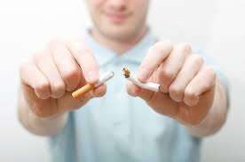
If you smoke to relieve unpleasant feelings, it is important to learn how to manage them. Unpleasant feeling like
stress, anxiety, depression, loneliness and any other fears are popular reasons why most adults smoke.
There are several healthier methods of checking your unpleasant feelings instead of smoking cigarettes. These methods include exercising, meditating, taking slow and deep breaths.
Always find ways on how to trigger smoking sensation to go away. Do things to distract you from smoking like. For instance you can keep telling yourself you’ll go back to smoking after a month. After the end of one year, when you’ll decide to go back to smoking, your answer will be “no”.

Slide 11

Never smoke again, not even a little.
When your friends smoke around you, it might be difficult to quit, but you must keep in mind that you’ve changed your habit and let them know that they won’t manage to smoke in your presence or in your car.
It is important to find non smokers and have time with them instead.

Slide 12

Always keep reminding yourself why you quit, focusing on the reasons and benefits of quitting.
If you find yourself lighting up a cigarette. Be aware that these cravings will pass and try to wait for it to go. It is important to get prepared and have a plan to cope with them with determination.

Slide 13
The most common methods of coping with cigarette cravings are:
  Find an oral substitute by keeping other things around to put into your mouth when cravings hit.
  Keep your mind busy by playing games or reading.
  Keep your hands busy to satisfy the need of tactile stimulation.
  Brush your teeth to keep away cravings.
  Drink water to stay hydrated. This minimizes nicotine
withdrawal symptoms.
  Lighting something else instead of lighting a cigarette
  Get active. Do anything like walking, stretches or running to get active.
  Try to relax by doing something that calms you down.

Slide 14
Hypnosis – is an option that has worked miracles in increasing your negative feelings toward smoking. It is the most popular option you can find in quit smoking Brisbane.
Motivational therapies. There are several ways you can motivate yourself from smoking cravings. One major way used is calculating financial savings. If you can calculate how much money you’ve used in smoking, it may be enough to buy you luxuries.
Behavioral therapies. This involves learning of new habits and coping skills because smoking is related to habitual behavior.

Slide 15

Failure of smoking again
It is normal when you try several times, if you’ve smoked again it doesn’t mean that you are a
smoker again, but don’t let it overpower you.
If you start smoking again it is time to call your
doctor to find out what didn’t work.
Learn from experience and improve On what will be helpful to you. You Can learn form this mistake and let It motivate you harder. Do not use it As an excuse to start smoking again.

Slide 16

There is no turning back. Now that you’ve
followed all techniques and you don’t risk from any disease, stop smoking and think about your health.
By utilizing quit smoking Brisbane, You can solve the smoking problem by getting out of the addiction, breaking the habit and dealing with the withdrawal cravings.
You can outdo this addiction and live your Healthy lifestyle for good.

Slide 17


